Slide 2
Mind’s On – Quote Perspectives
Read the following quote:
“A woman’s place is any
place she wants to be.”
Write down what your response to this quote would be if you lived in the 1920’s
Write down what your response to this quote is now in 2013

Slide 3
“WOMEN ARE PERSONS TOO”:
The Role of Women in the 1920’s

Slide 4
Women Against Alcohol
Many women’s groups believed the country’s use of liquor created financial problems, crime, and often physical and mental abuse within the family

Slide 5
Temperance
The Women’s Christian Temperance Union worked to ban the sale of liquor in Canada
Prohibition was officially introduced in Canada March, 1918, as part of the war effort

Slide 6
Political Action
In 1916, the City of Edmonton appointed Emily Murphy as Judge of the Juvenile Court
Murphy was the first female judge in Canada

Slide 7
She was challenged her first day of work, based on an outdated law that only a “qualified person” could preside on the bench
British law considered only men as persons; women were not even mentioned

Slide 8
Agnes Macphail
Agnes Macphail was the first woman elected to the House of Commons (1921–40) and was one of the first two women elected to the Ontario legislature (1943–45, 1948–51).
She was also the first female member of a Canadian delegation to the League of Nations, where she served on the disarmament committee.

Slide 9
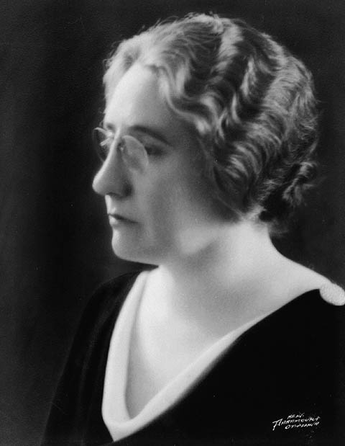
Agnes Macphail
Although Macphail had an official seat in the House of Commons, she was not technically considered a “person” under Canadian law.

Slide 10
The Law Is Challenged
In 1921, the Montreal Women’s Club asked PM Borden to appoint Emily Murphy to the Canadian Senate
She was an excellent candidate: The women wanted to test the law
Borden would not go against the law and appoint her

Slide 11
The Alberta Famous Five
By 1927, Emily Murphy stood up to the government with a group of very influential women:
Nellie McClung
Louise McKinney
Henrietta Muir Edwards
Irene Parlby

Slide 13
Victory for Women
The government won the first challenge based on the law of 1867
The Alberta Five took their case to the Court of Appeal in Britain in 1929
They won and were declared ‘persons’ under the law

Slide 14
Big Idea
Murphy never became Senator (another women was appointed in 1930) but…
This was a major triumph for women’s rights in Canada

Slide 15
Video Clip on Nellie McClung

Slide 16
Your Task…
In Partners, you will create a “Main Ideas” poster hi-lighting the important aspects of the life of your Alberta Five person!
You should include:
At least 5 points (in complete sentences) summarizing the main idea of your reading.
Your person’s NAME!
At least two images that represent your person (can be their face!)
The quote at the top of the page plus an explanation

Slide 17
Reading Activity
Based on the reading you get do the following on a the Alberta Five chart:
Write the persons name as the title
Copy down the quote and underneath write down what you think it means
Read the article on your own and identify things that you would consider to be main points or “Big Ideas”
Compare notes with others to fill in your chart

