Slide 1
Universal Declaration of Human Rights!

Slide 2
If you had to make laws for the entire world to follow, what would they be?
Remember, you are a dignified world leader and actually deeply care about the well being of all people on earth!
If you do not take this activity seriously, you will get a zero!

Slide 3
Is there a world leader?

Slide 4
The United Nations
The United Nations is the closest group we have to a global authority.
The United Nations is an intergovernmental organization to promote international co-operation and to create and maintain international order.
Draw this!

Slide 5
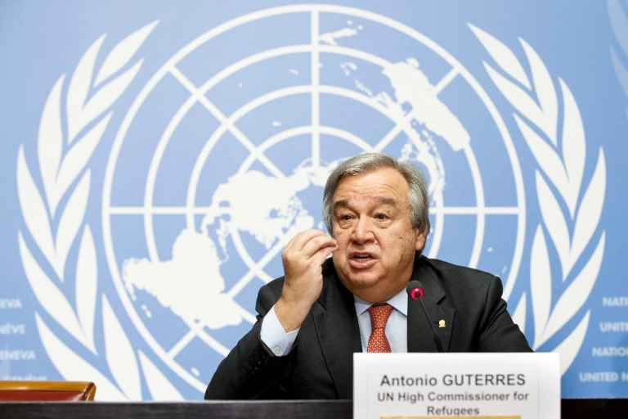
Leadership
The Secretary-General of the United Nations is a symbol of the Organization's ideals and a spokesman for the interests of the world's peoples, in particular the poor and vulnerable.
The current Secretary-General of the UN, and the ninth occupant of the post, is Mr. António Guterres of Portugal, who took office on 1 January 2017.
The UN Charter describes the Secretary-General as "chief administrative officer" of the Organization.

Slide 6
Watch!
http://www.youthforhumanrights.org/what-are-human-rights.html

Slide 7
Look at the list! What would you omit to replace with a better Right?

Slide 8
The Canadian Charter or Rights & Freedoms 1982
Guarantee of Rights and Freedoms
Rights and freedoms in Canada
1. The Canadian Charter of Rights and Freedoms guarantees the rights and freedoms set out in it subject only to such reasonable limits prescribed by law as can be demonstrably justified in a free and democratic society.

