Slide 1
The Executive Branch of Government
The executive branch carries out the plans and policies of the government.

Slide 2
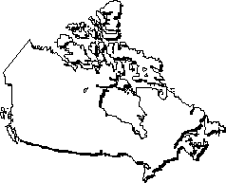
Federal Executive Branch
Prime Minister - Stephen Harper
Leader of the nation. Speaks on behalf of all Canadians at national and international meetings.
What else?

Slide 3
The Cabinet
- Each cabinet member is given responsibility for one department of the government such as education, agriculture and transportation. Members of the cabinet are called ministers
Ministers introduce what?

Slide 4
Public Service
Also called the civil service
Work to provide government services (carry out the daily business of the federal government i.e deliver mail, gather statistics, research information to help in making new policies etc.)

Slide 5
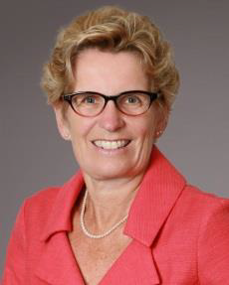
Provincial Executive Branch
Premier - Leader of the provincial party in power
Cabinet - Very similar responsibilities to the federal cabinet only at the provincial level
Provincial public service - Work to provide government services at the provincial level i.e. teachers, provincial police, nurses etc.

Slide 6
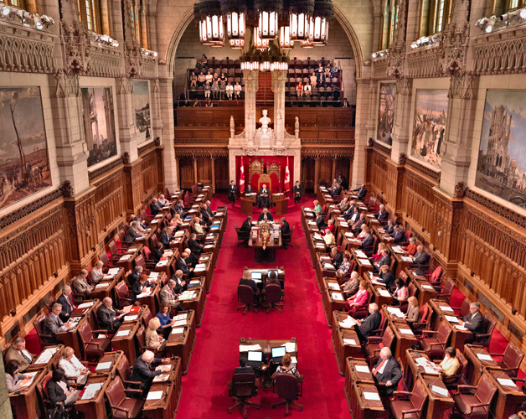
The Legislative Branch of Government
The legislative branch has the power to make and change laws. Also called Parliament. (LEGislative think "LEGal"!)

Slide 7
Governor General is the Queen’s representative in Canada.
The Governor General usually serves for five years. One of the most important roles of the Governor General is to ensure that Canada always has a Prime Minister.
The Governor General acts on the advice of the Prime Minister and Cabinet.
Duties?

Slide 8
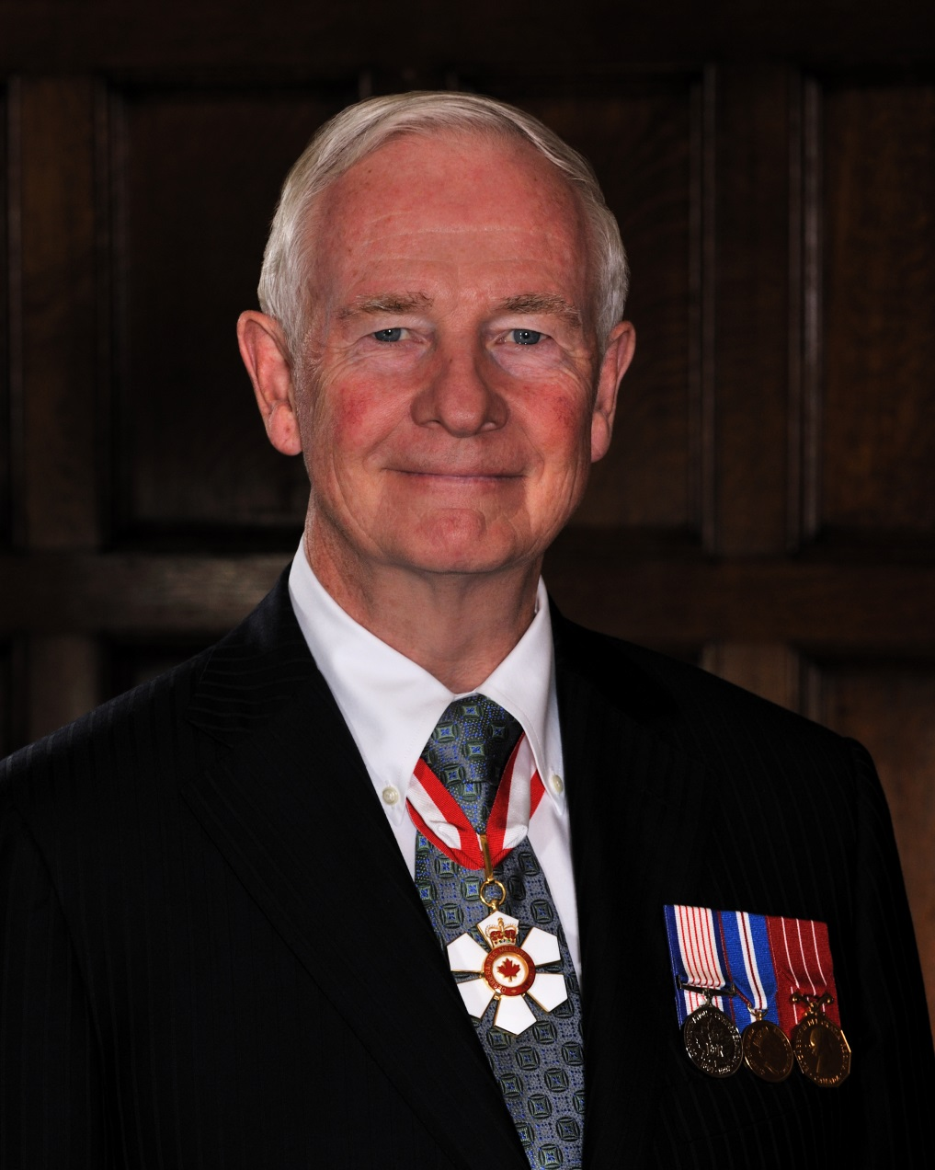
David Johnston

Slide 9
The Senate
Referred to as the "upper house of Parliament” as well as the “chamber of sober second thought” because they are not elected so they do not feel the pressure to vote any specific way to please voters.
Its primary function?
No bill can become law until it has been passed by the Senate.
What else does the senate do?
The Senate is currently a hot topic for reform as many Canadians question the usefulness of the Senate especially considering the enormous cost involved in running it.

Slide 10
The House of Commons
Most powerful part of the legislative branch at the federal level
The House of Commons is the major law-making body in Parliament. On Parliament Hill in Ottawa, in the Commons Chamber, elected members (MPs) devote most of their time to debating and voting on bills. The Chamber is also a place where Members represent constituents’ views, discuss national issues and call on the government to explain its actions.
Consists of 308 seats – one for each MP - determined by Canada's population including the Prime Minister.
WHAT ELSE?

Slide 11
The Opposition
The role of the Official Opposition is to challenge government policies, hold the government accountable for its actions and give voters an alternative in the next election.
Leader of the Opposition?

Slide 13
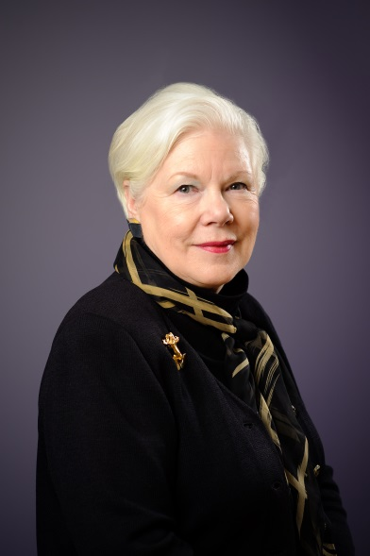
Lieutenant Governor - Elizabeth Dowdeswell
Legislative Assembly: Provincial equivalent to the House of Commons. In Ontario, the elected Members of Provincial Parliament (MPPs) make up the legislative assembly. In Toronto, MPPs meet to discuss debate and vote on public issues at Queen's Park.
There is no senate at the provincial level.

