Slide 1
The End of the War The Liberation of Europe, VE & VJ Day

Slide 2
Liberation of Europe
From D-Day to April 1945 pushed the Germans back to Berlin
The final defence of Berlin included young boys and the elderly – The German army was defeated

Slide 3
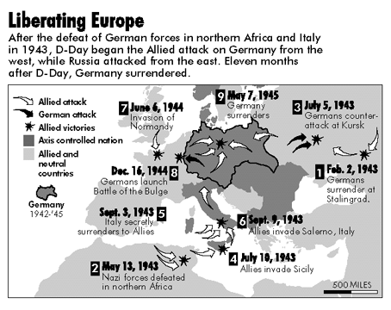

Slide 4
Russians Advance to Reichstag

Slide 5
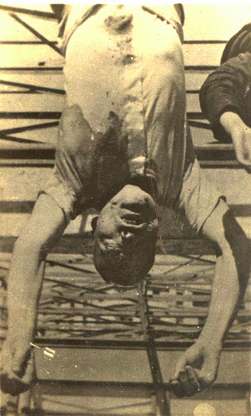
The End of the Dictators
In Italy Mussolini is captured and hanged by his own people (April 1945)

Slide 6
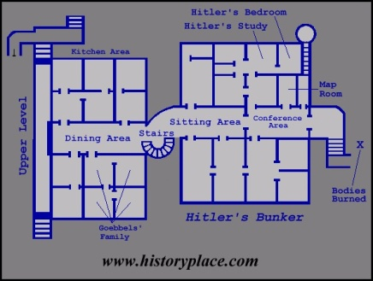
Hitler’s Death
Hitler commits suicide and orders his body burned afterwards – April 30, 1945
Nazi propaganda says he died a hero’s death leading his troops in battle

Slide 7
VE Day
One of Hitler’s final orders is to fight to the death
Germany formally surrenders May 8, 1945
Although very important, war still continues in Japan

Slide 8
The World Celebrates!
Parliament Hill, Ottawa
May 8, 1945
Parliament, London, England
Times Square, New York

Slide 9
The Responsibility - Peter Appleton
I am the man who loads the Bomb That he must drop should orders come From him who gets the word passed on By one who waits to hear from him. I am the man who makes the Bomb That he must load for him to drop If told by one who gets the word From one who passes it from him. I am the man who fills the till, Who pays the tax, who foots the bill That guarantees the Bomb he makes For him to load for him to drop If orders come from one who gets The word passed on to him by one Who waits to hear it from the man Who gives the word to use the Bomb. I am the man behind it all; I am the one responsible.
I am the man who gives the word, If it should come, to use the Bomb. I am the man who spreads the word From him to them if it should come. I am the man who gets the word From him who spreads the word from him. I am the man who drops the Bomb If ordered by the one who's heard From him who merely spreads the word The first one gives if it should come.

Slide 10
Dropping the bomb and VJ day
Notes:
The BBC Video: Era of the SWW – Making The Peace, has a series of clips that will help to supports this presentation. You can also download my source booklet from www.schoolhistory.co.uk : The Use of the Atomic Bomb.

Slide 11
Background – The Manhattan Project
TMP was the U.S. government research project (1942–45) that produced the first atomic bombs.
Canada supplied and refined uranium for use in U.S. facilities.

Slide 12
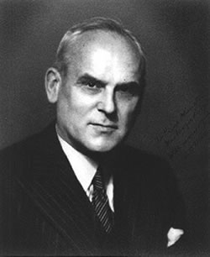
C.D. Howe
Canada's wartime cabinet minister who formally entered Canada into the nuclear age.

Slide 13
On August 6th 1945 the Americans dropped the world’s first atomic bomb on Hiroshima
August 9th they dropped another bomb on Nagasaki
The Japanese surrender on August 10th.

Slide 14
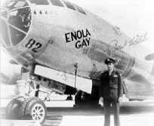
The pilot was Paul Tibbets
The plane that dropped the bomb was the Enola Gay
It was named after the pilot’s mother

Slide 15
Fat Man was dropped on Nagasaki
Little Boy was dropped on Hiroshima

Slide 16
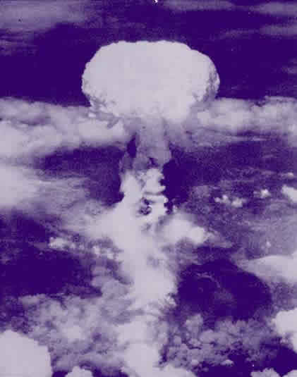
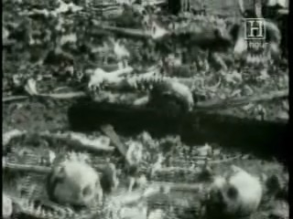

Slide 17
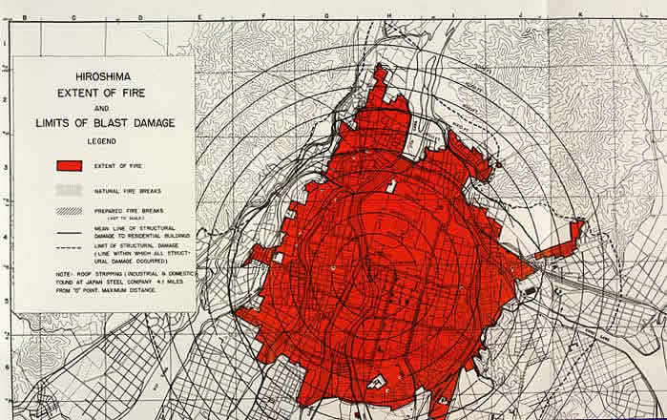
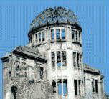
The Damage to Hiroshima
The centre of the explosion was hotter than the surface of the sun!

Slide 18
Casualties
It estimated that at Hiroshima 70,000+ died instantly – Over 250,000 died later from results of the explosion or radiation sickness
At Nagasaki over 50,000 were killed instantly with many more after as well

Slide 19
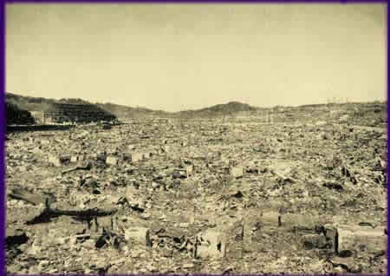

Slide 20
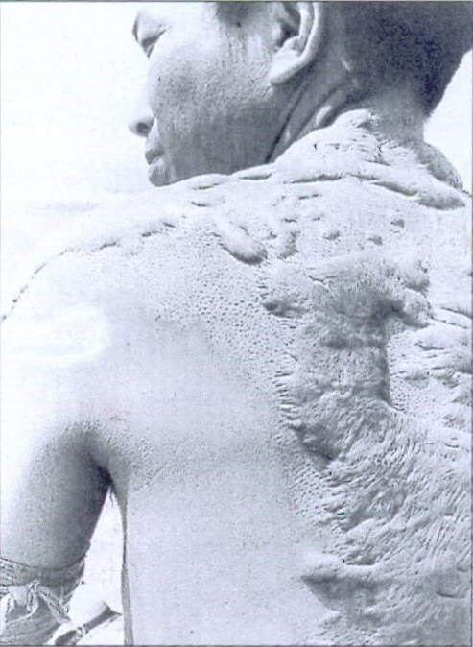
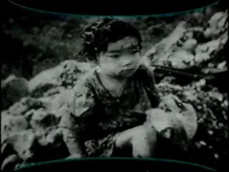
Survivors from Hiroshima

Slide 21
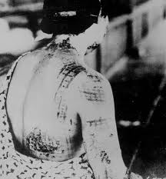
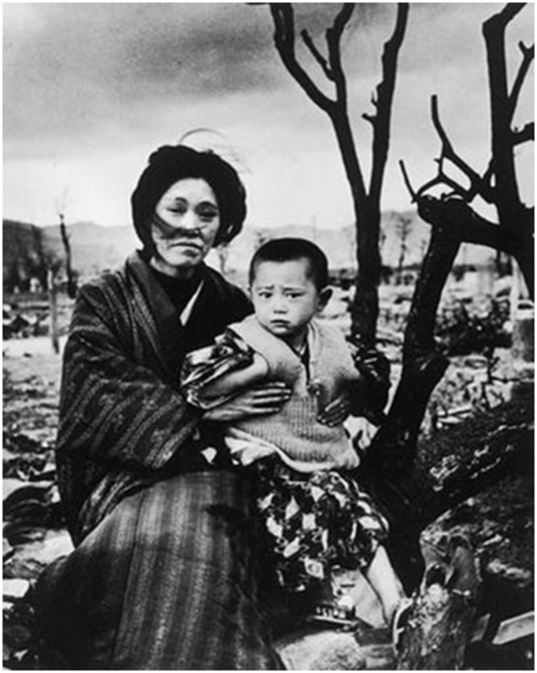
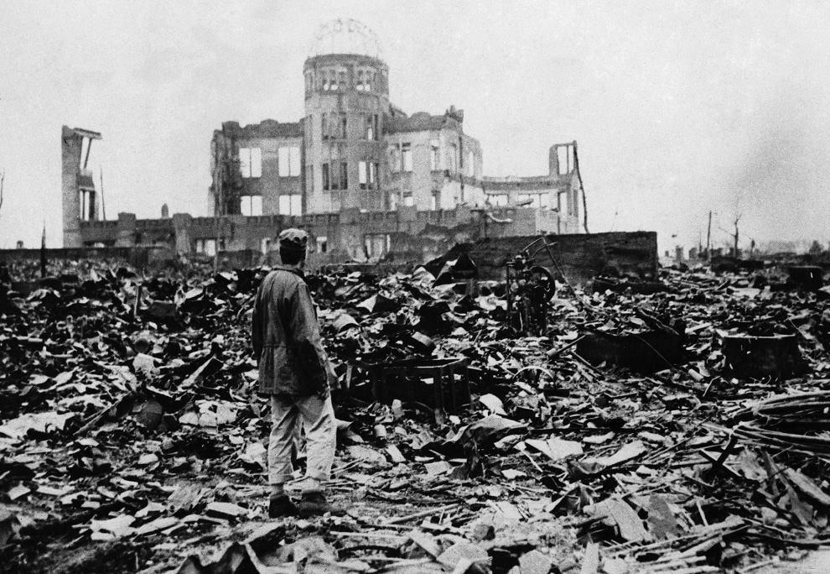

Slide 22
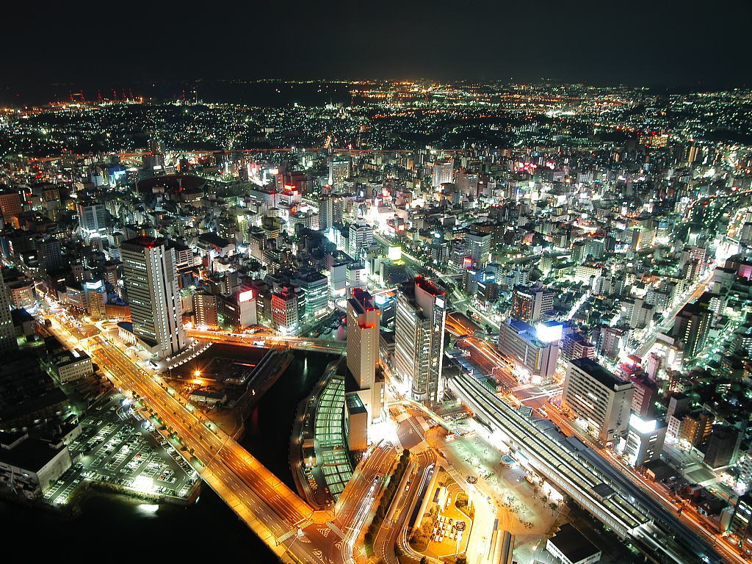

Slide 23
Primary Sources – Different Interpretations
As a group read the primary sources on the “Was the Dropping of the Bomb Justified?”
Next, re-read the sources on your own and on the chart fill in what you think the reason/justification for dropping the bombs was.
What do you think? Do any of these reasons justify the deaths of so many innocent civilians?

