Slide 1
Character Analysis in Lord of the Flies
Simon

Slide 2
Simon’s humble origins
Originally a member of the choir, Simon was considered weak as he was known for fainting and is seen as being strange by the others.
Main Actions in the novel:
Has a fit as he marches along the beach in the choir
Goes exploring with ralph and Jack
Goes off alone into the forest
Gives a piece of meat to Piggy
Conversation with the ‘Lord of the flies’, and faints after doing so
Discovers the dead parachutist on the mountain-top
Killed when he discovers the truth about the beast

Slide 3
Thoughtful and Kind
Simon alone helps Ralph to build shelters while the other boys go to play or to hunt.
“All day I’ve been working with Simon. No one else. They’re off bathing, or eating, or playing,” (Ralph)

Slide 4
Stands up and protects Piggy when Jack is nasty towards him.
When Jack breaks Piggy’s glasses, Simon finds them and hands them back to him
Jack won’t give Piggy meat, so Simon gives him his own.

Slide 5
Protects the Littluns
He stops and picks high fruit for them from the trees – they follow him into the forest and is someone for them to follow.
“[he] pulled off the choicest from up in the foliage, passed them back down to the endless, outstretched hands.”

Slide 6
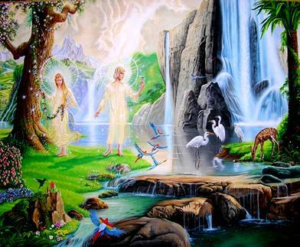
Simon as a Christ Figure – Does Simon Represent Jesus?
The island, and particularly Simon’s glade, represent the Garden of Eden
The island is originally pristine and uncorrupted by the introduction of evil, similar to Eden.

Slide 7
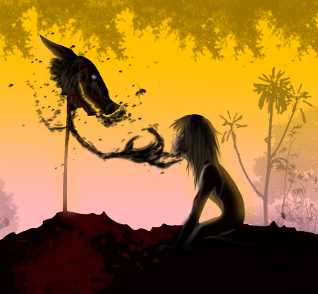
Enter the Lord of the Flies (or pig head on a stick)
The Lord of the Flies represents the devil and the promotion of evil among humankind.
Simon is the one who arrives at the moral truth of the novel before anyone else – and dies before he has the chance to educate the group…the evidence disappears with his death.

Slide 8
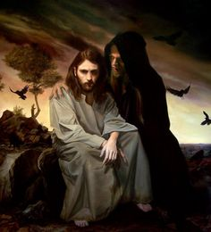
Simon as a Christ Figure
The conversation Simon has with the Lord of the Flies mimics the conversation Jesus had with the devil during his “40 days in the wilderness” (Matthew 4:1-11)
The other boys kill him sacrificially as a consequence of having discovered the truth.

Slide 9
Irony
Simon wants to reassure the others about the beast, but this leads him to his death
“The beast was harmless and horrible, and the news must reach the other as soon as possible.”

Slide 10
Simon as a Spiritual Figure
Does nothing to harm people
Hands out food to the littluns
Makes a foreseeing/foreshadowing announcement. Tells Ralph that he will make it home. (Ironic that Simon, himself, will not)
Dies for telling the truth
“What I mean is…maybe it’s only us”

Slide 11
“There were no words, and no movements but the tearing of teeth and claws”
However, this “Christian Allegory” is incomplete as Simon’s death does not bring salvation to the island, and with his death, the truth is actually lost.
The boys use their bare hands and teeth to tear at Simon’s flesh and beat him to death.
Even Piggy and Ralph are involved in this animalistic savagery.
Shows what even the most decent human beings are capable of – this is the beginning of open savagery and murder on the island
What do you think Goldin’s view of Christianity was?

Slide 12
