Slide 2
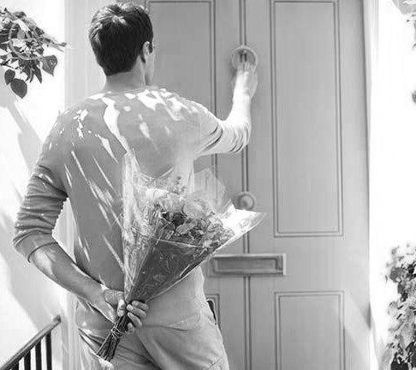

Slide 3
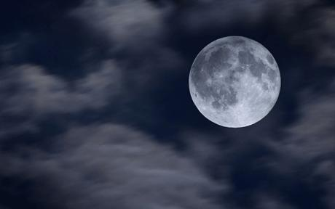

Slide 4
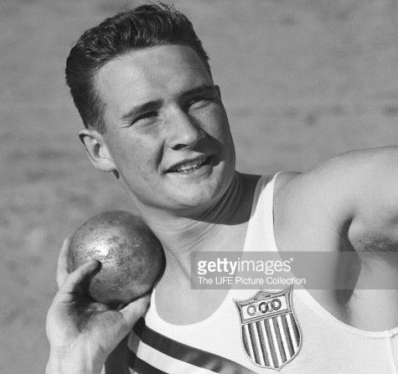

Slide 5
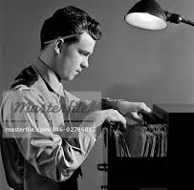

Slide 6
The accent of a coming foot

Slide 7
A pretty trap

Slide 8
This is my sister: Celebrate her with strings

Slide 9
Not Jim!

Slide 10
Terror!

Slide 11
The Opening of a Door!

Slide 12
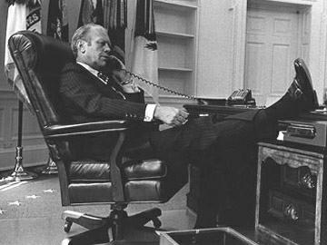

Slide 14
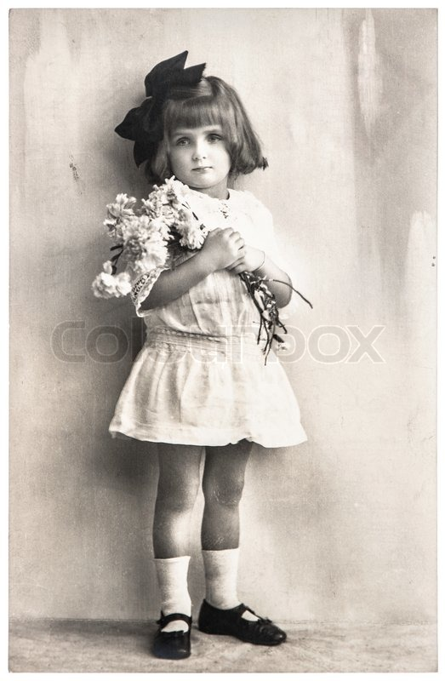

Slide 15
Terror!

Slide 16
Ah!

