Slide 1
Point of View
The Eyes of the Narrator

Slide 2
What is POV?
The narrator’s position in relation to the story being told.
The narrator IS NOT the author.
The narrator is the character who is telling the story. It is a character created by the author.

Slide 3
Types of POV
Objective
First Person
Third Person

Slide 4
Objective
Just the facts
The reader is not given access to the characters thoughts.
The reader has to judge what the character is thinking or feeling by what they say, what they do, and their facial expressions.
This POV is a lot like real life.

Slide 5
Example
John laughed hollowly. “You’re joking,” he said. The neon light flickered on his face, turning it a ghastly yellow.
Veronica shook her head slowly. Her fingers were busy shredding her tear-stained paper tissue. “I’m not joking. It’s all true.”
John stood up and banged his fist against the wall, hard, once. He was shaking his head in disbelief. “I’ll have to leave now,” he said, his voice terse.

Slide 6
First Person
When you are in the narrators head.
You see the story through their eyes.
We know the narrators thoughts.
“I” and “We” are key words to look for.
These narrators can be reliable or unreliable.
A very personal form of writing.

Slide 7
Example
When I really worry about something, I don't just fool around. I even have to go to the bathroom when I worry about something. Only, I don't go. I'm too worried to go. I don't want to interrupt my worrying to go. J.D. Salinger, The Catcher in the Rye, Chapter 6

Slide 8
Third Person
The narrator is not a character in the story at all.
We gain access to some or all of the characters inner thoughts.
Think of this narrator as a God that sees everything and knows everything.
Key words are: he, she, they.

Slide 9
Example
There was a roar and a great confusion of noise. Fires lept up and licked the roof. The throbbing grew to a great tumult, and the Mountain shook. Sam ran to Frodo and picked him up and carried him out to the door. And there upon the dark threshold of the Sammath Naur, high above the plains of Mordor, such wonder and terror came on him that he stood still forgetting all else, and gazed as one turned to stone.
LOTR – Tolkien

Slide 10
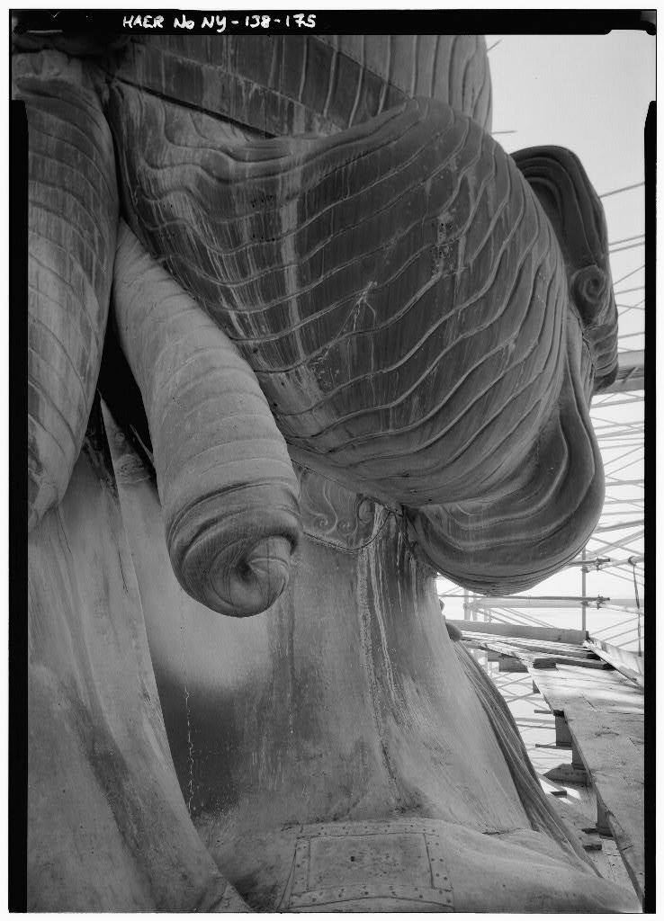
Objective

Slide 11
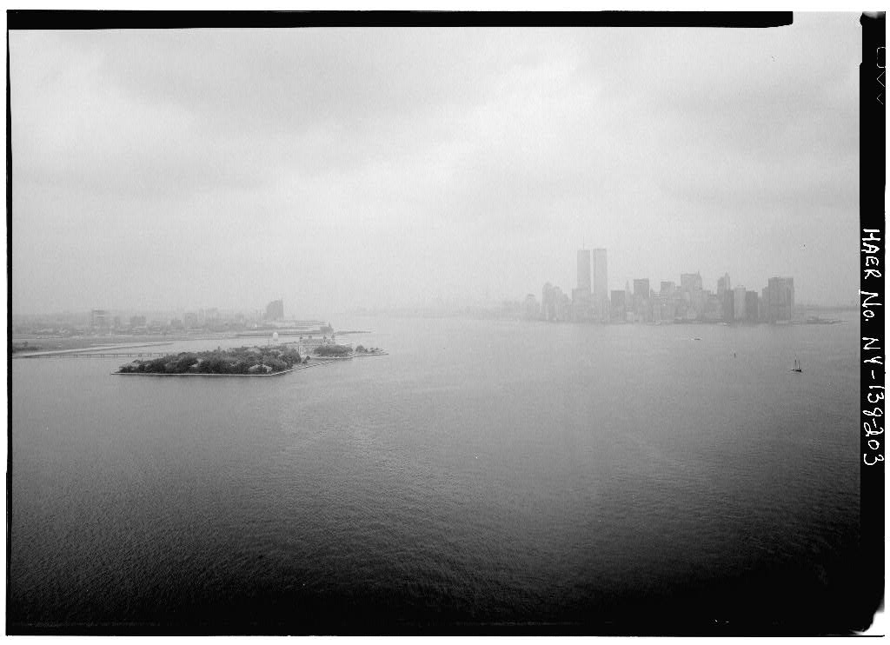
First Person

Slide 12
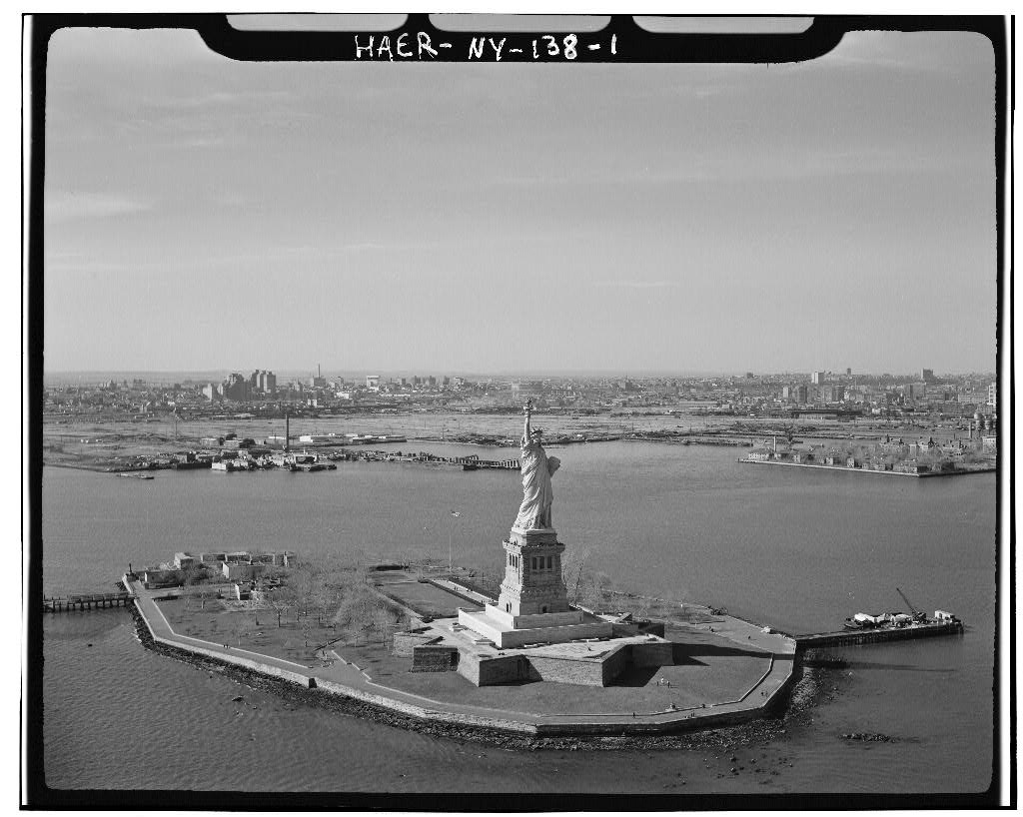
Third Person

