Slide 1
The Merchant of Venice - Historical Context

Slide 2
History
Venice in the late-1500’s
The richest city in Europe
Home to many tradesmen, foreigners, and different religious views
Jewish people were targeted – negatively

Slide 3
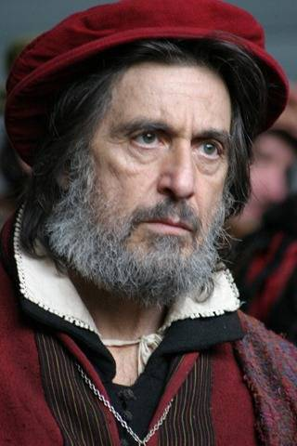
History
Religious Intolerance
Jewish people confined to ghetto - Gated “community”
Treated with little or no respect
Kicked or spit on
Cheated
Forced to wear red caps
Can be seen in The Merchant of
Venice!

Slide 4
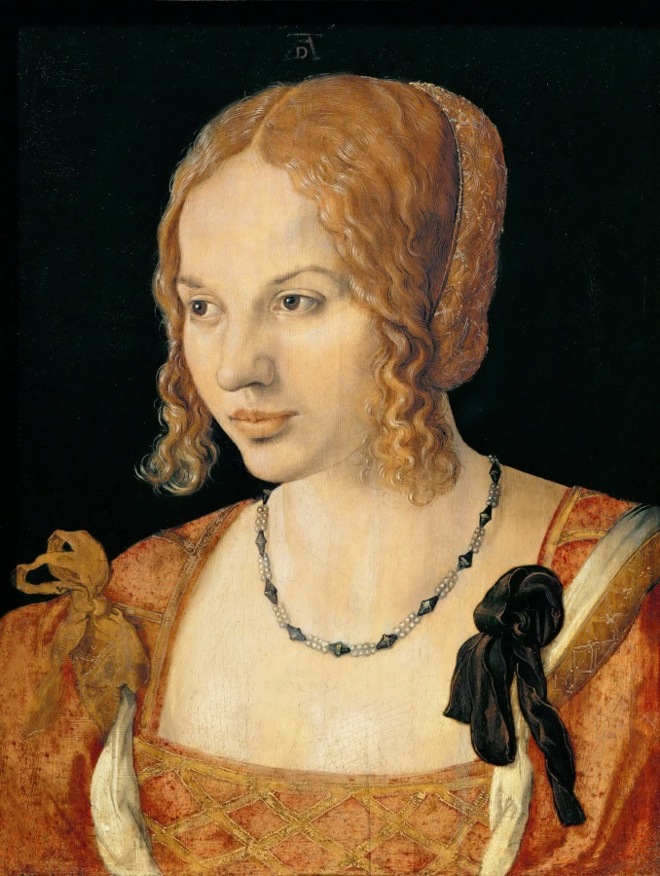
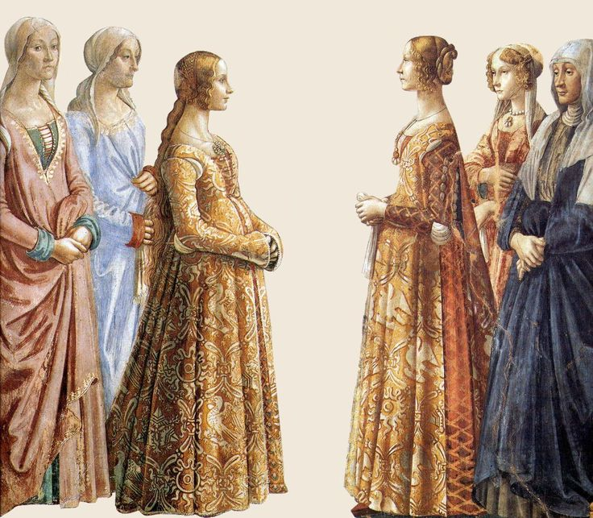
History
Venetian Women
Not respected
Under the rule/command of men
In the play: Jessica and her
father, Portia and her father
No political power

Slide 5
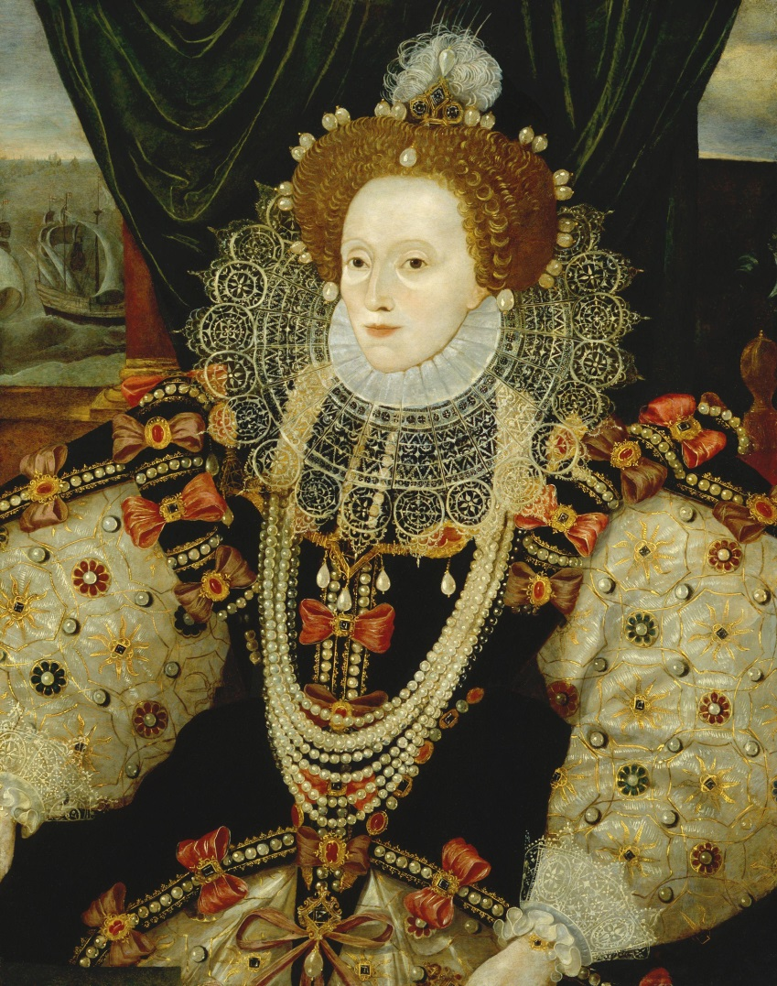
Shakespeare’s England (in the mid-1500’s)
Under the rule of Queen Elizabeth I
Jews expelled in the Middle Ages
Nation-wide conflict between Catholics and Protestants
Playwrights had to be careful not to offend anyone; especially the Queen!

Slide 6
Character Task
Make a list/chart to identify the major characters in the play. What are their roles? Who are they?
What do their names mean? Can you make any predictions?

