Slide 1
It’s Over

Slide 2
The End of the War and the Treaty of Versailles
At 11 o'clock in the morning of the 11th day of the 11th month of 1918, the First World War--known at the time as the Great War--comes to an end.

Slide 3
In the fall of 1918, the power held by the Triple Alliance was unraveling in its war effort.
Issues:
better supplied and coordinated Allied powers
facing exhausted resources on the battlefield
turmoil on the home front
- surrender of Germany’s weaker allies, Austria-Hungary, Bulgaria and the Ottoman Empire, forced the country to seek an armistice with the Triple Entente in the early days of November 1918.

Slide 4
Mind’s On – Group Think/Share
Groups of 4
Read over and understand your card and who you are.
In your group, answer the questions from your handout on your chart paper.
You MUST come up with an agreement for the fate of Germany!

Slide 5
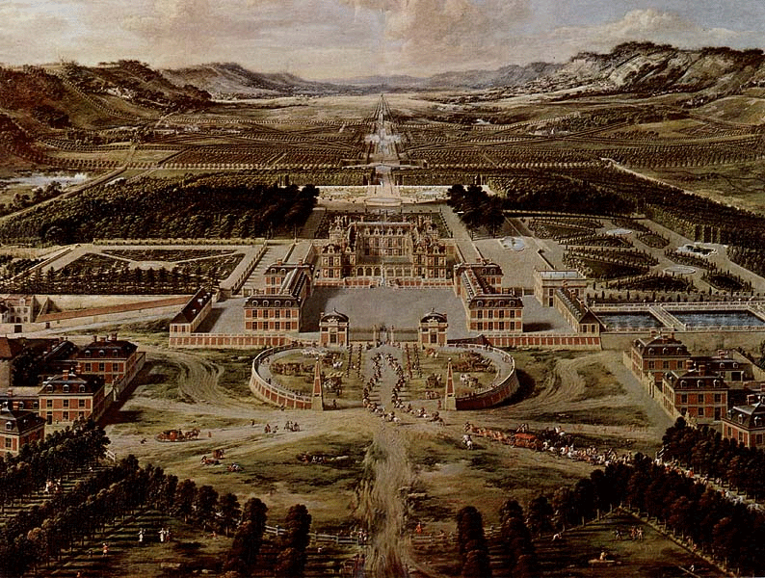
The Treaty of Versailles

Slide 6
The Details
The Treaty of Versailles was made by the victorious nations after WWI (in June 1919)
This group was known as the League of Nations

Slide 7
Their goal was to prevent the start of another World War
Most Germans thought the Treaty was unfair. This led to anger and embarrassment

Slide 8
Conditions of the Treaty
Geography
Germany lost all of their colonies
They lost land to France in the west
They also lost much of Eastern Europe, which created Poland
France also took control of many of their resources (coal)

Slide 9
Military
The German army was restricted to 100,000 people
No tanks or heavy guns
No air force
The navy could only have small ships (no subs!!)

Slide 10
Reparations
This means to give money to repair the damage of war
They had to pay Britain, France and Belgium money and goods
This was estimated at about 31 billion dollars (about 440 billion dollars today)

Slide 11
Who am I? Can you guess?
War Guilt Clause
Germany was forced to sign a statement that the war was their fault
This made Germany very angry and hurt their pride
This will soon have a large impact on the new Nazi Party

Slide 12
Making Predictions…
In your green journals, predict how Germany will react to the terms that finalize the War to End All Wars.
How would you react if your were a German citizen (take into consideration the number of soldiers killed reached more than 1.7 million where British Empire lost approximately 900 000, approx. 500 000 civilian deaths, the loss of resources and man power.
If you are well aware of the outcome, what should the Treaty of Versailles included?

