Slide 1
Human Rights: Convention on the Rights of the Child
Are the following images demonstrating human rights?

Slide 2
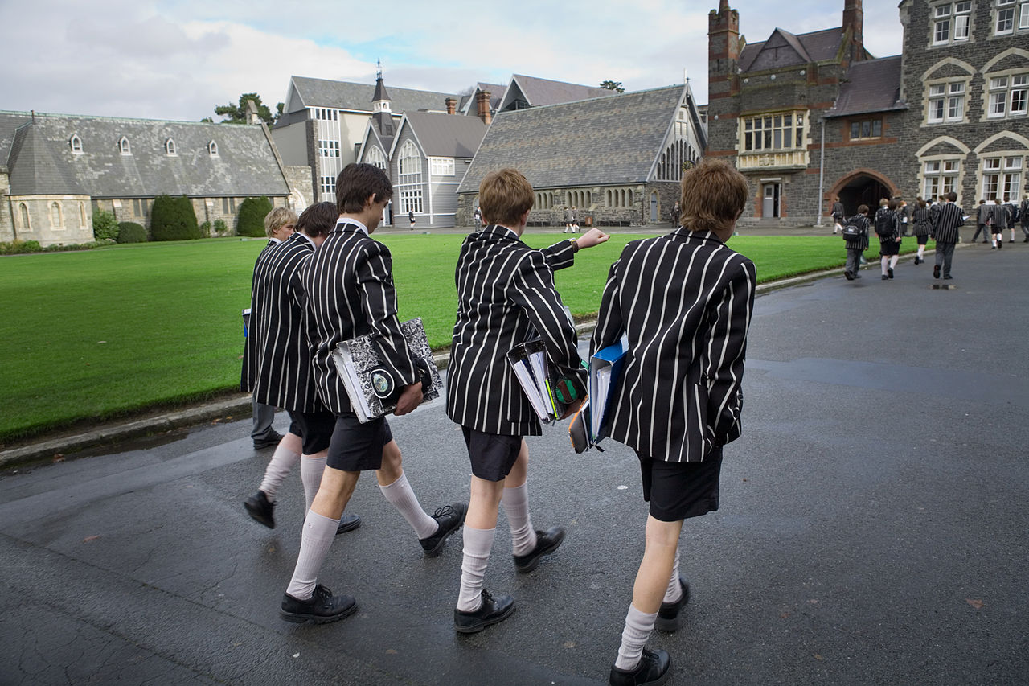
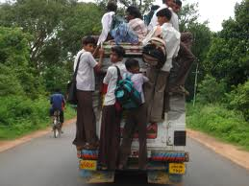
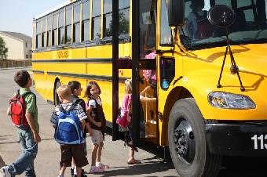

Slide 3
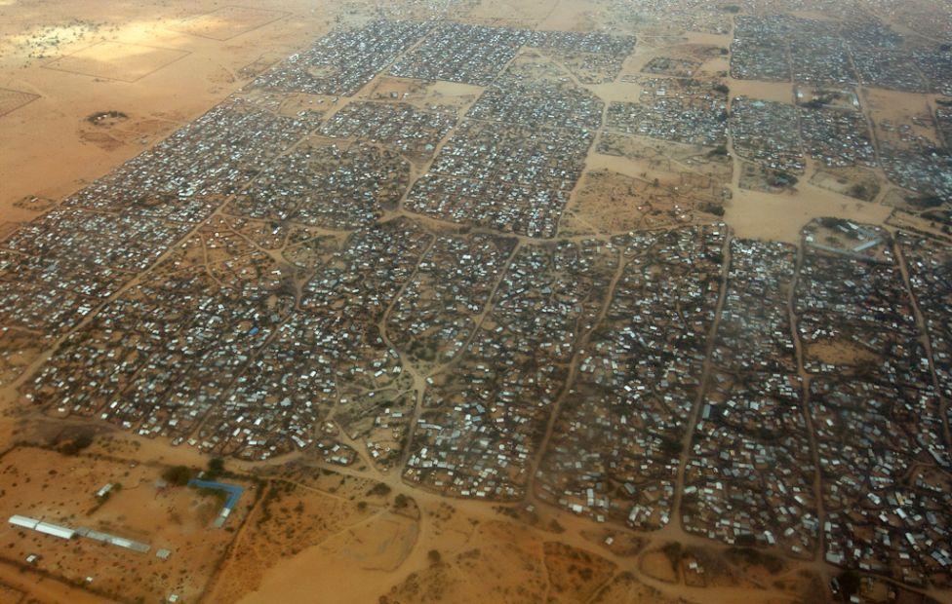
Dadaab Dagahaley, Kenya

Slide 4
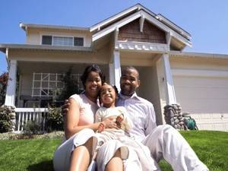

Slide 5
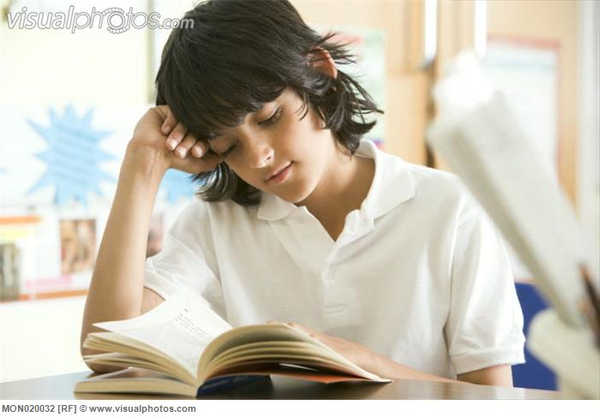

Slide 6
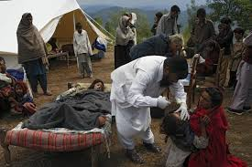

Slide 7
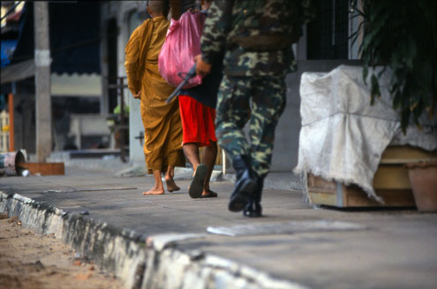

Slide 8
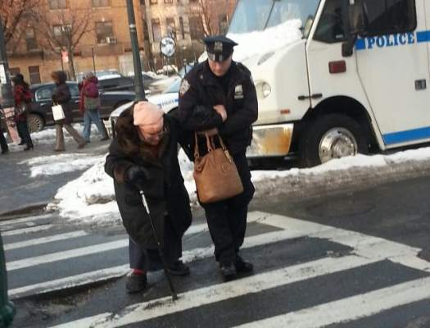

Slide 9
Can human rights ever be taken away? What does inalienable mean?

Slide 10
If all people have human rights, who defends those rights? Are all people capable of defending human rights? Do humans have the responsibility to defend the rights of others?

Slide 11
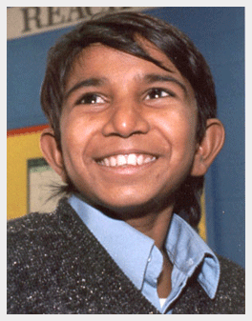
Iqbal Masih
How can a child speak out against human rights abuses?

Slide 12
In your notes…
1. What might happen if people did not protect human rights?
2. What happens when all people defend human rights?
3. How could the participants take action to protect human rights?

