Slide 1
WHAT ARE HUMAN RIGHTS?
Civil Rights
Political Rights
Economic Rights
Social Rights
Cultural Rights

Slide 2
WHAT ARE HUMAN RIGHTS?
Human rights are rights inherent to all human beings, whatever our nationality, place of residence, sex, national or ethnic origin, colour, religion, language, or any other status.
We are all equally entitled to our human rights without discrimination.

Slide 3
WHAT ARE HUMAN RIGHTS?
These rights are all interrelated, interdependent and indivisible.
Universal human rights are often expressed and guaranteed by law, in the forms of treaties, customary international law , general principles and other sources of international law.
International human rights law lays down obligations of Governments to act in certain ways or to refrain from certain acts, in order to promote and protect human rights and fundamental freedoms of individuals or groups.

Slide 6
WHERE DO RIGHTS COME FROM?
Human rights are based on the values of:
• Dignity
• Justice
• Respect
• Equality Human rights were officially recognised as values by the world when the United Nations was set up.

Slide 7
WHAT IS THE UNITED NATIONS?
The United Nations (UN) is an international organisation that was established in 1945, the year the Second World War ended.
Its founders hoped it would be able to prevent catastrophes like the Holocaust from happening in the future.
So promoting human rights became an aim of the UN, along with maintaining international peace and reducing poverty.

Slide 8
THERE ARE 30!
The United Nations Universal Declaration of Human Rights (UDHR) is the most famous human rights agreement in the world. It contains 30 human rights.

Slide 9
THESE ARE SOME OF THE RIGHTS:
Life, liberty and security.
Freedom from slavery and torture.
Freedom from discrimination.
Equality before the law.
A fair and public trial.
Be considered innocent until proven guilty.
Privacy.
Freedom of movement.
Seek and enjoy political asylum in other countries.
A nationality.

Slide 10
1. Marry and have a family. 12. Own property. 13. Freedom of thought, conscience and religion. 14. Freedom of opinion and expression. 15. Hold peaceful meetings. 16. Work. 17. Rest and leisure. 18. Food, clothing, shelter, medical care and social services. 19. Education.

Slide 11
THE KEY MESSAGES OF THE UNIVERSAL DECLARATION ARE THAT HUMAN RIGHTS ARE:
• Universal
• Equal
• Interdependent & indivisible
• Inalienable

Slide 12
HOW DOES THE UDHR PROTECT HUMAN RIGHTS?
The UDHR is an international statement of values that has inspired over 80 treaties containing human rights laws, including the main UN human rights treaties.

Slide 13
HUMAN RIGHTS VIOLATIONS
Human rights violations occur when actions by state (or non-state) actors abuse, ignore, or deny basic human rights (including civil, political, cultural, social, and economic rights). Furthermore, violations of human rights can occur when any state or non-state actor breaches any part of the UDHR treaty or other international human rights or humanitarian law.

Slide 14
Human Rights Abuse
Human rights abuses are monitored by United Nations committees, national institutions and governments and by many independent non-governmental organizations, such as Amnesty International, International Federation of Human Rights, Human Rights Watch, World Organisation Against Torture, Freedom House, International Freedom of Expression Exchange and Anti-Slavery International.

Slide 15
Human Rights Abuse
These organizations collect evidence and documentation of alleged human rights abuses and apply pressure to enforce human rights laws. Wars of aggression, war crimes and crimes against humanity, including genocide, are breaches of International humanitarian law and represent the most serious of human rights violations.
The UN Security Council has interceded with peace keeping forces, and other states and treaties (NATO) have intervened in situations to protect human rights.

Slide 16
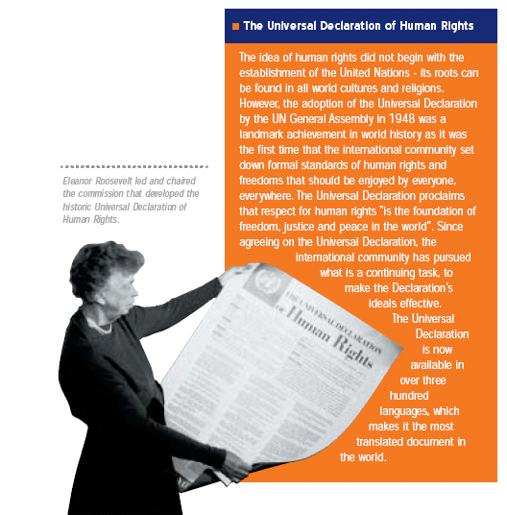

Slide 17
Human Rights Instruments coming soon…

