Slide 1
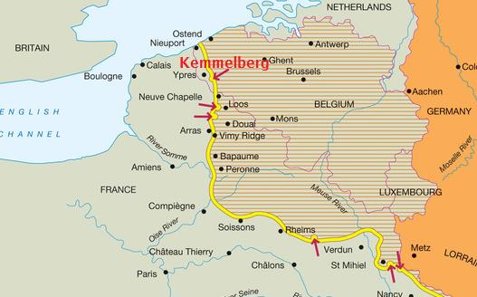
Horrors on the Western Front
Western Front: The region to the west of Germany where the Germans were fighting against the French. British and Canadian forces (Belgium, France, etc.)

Slide 2
The Trenches
Rows of deep trenches were dug due to trench deadlock.
Protected by sandbags and barbed wire.
These trenches stretched hundreds of kilometers from the English Channel to the border of Switzerland.
They twisted and turned across the countryside.

Slide 3
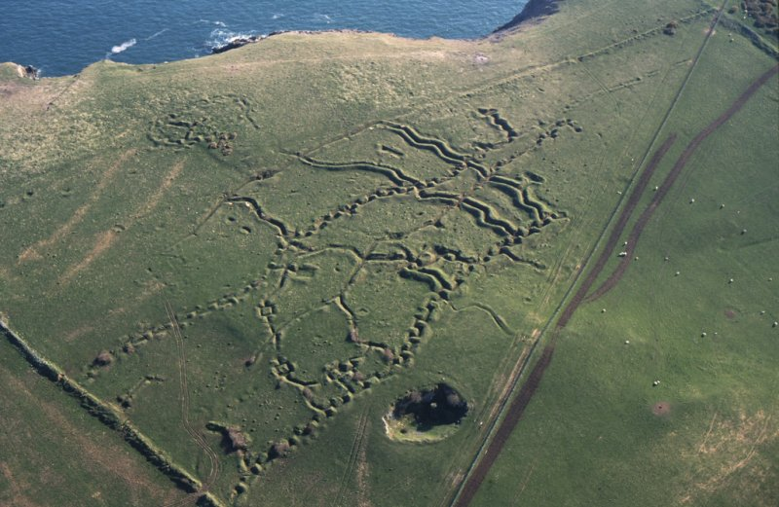
How WWI has scarred Europe…

Slide 4
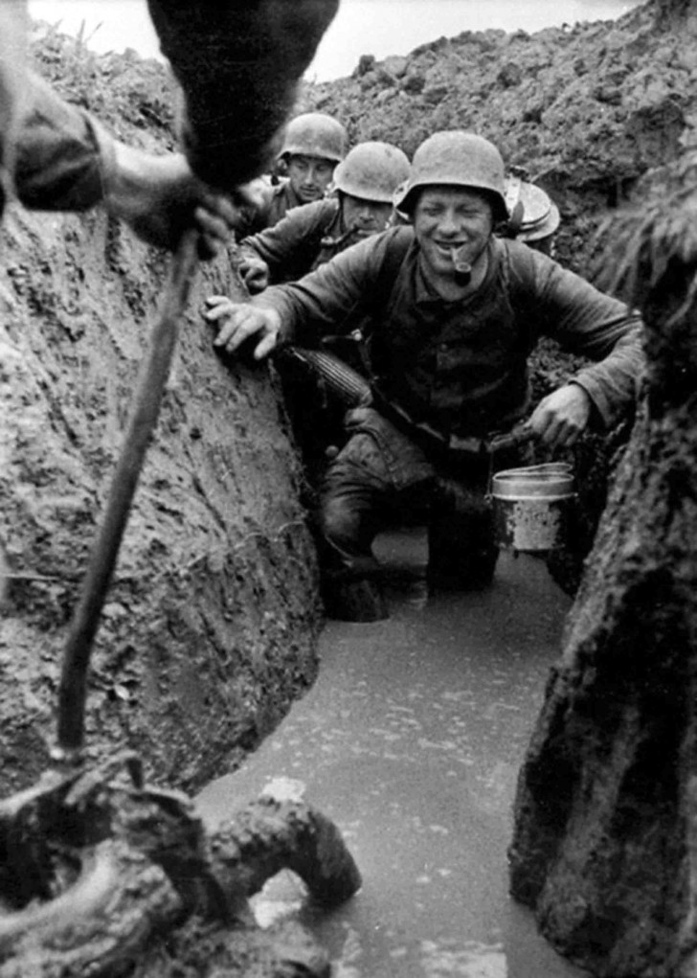
These trenches were dug as deep as possible, until the water came in.
The trenches were linked by traverses and tunnels.
Wet weather made the trenches slippery and waterlogged.
Med stood in water up to their knees,

Slide 5
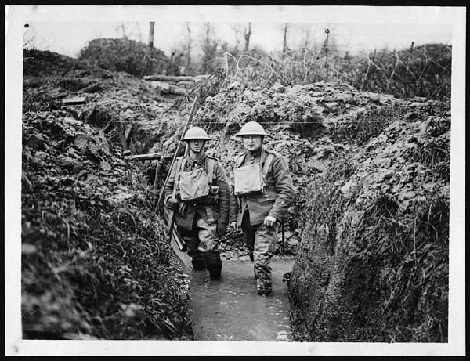
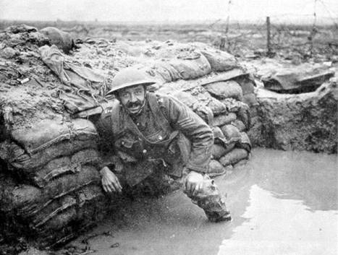

Slide 6
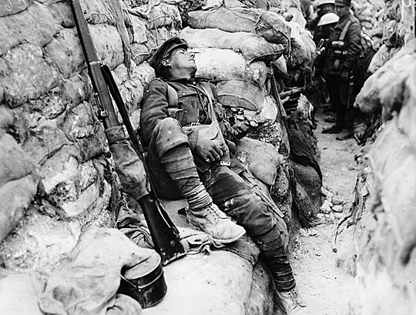
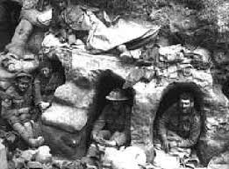
Soldiers slept in their uniforms, slumped on duckboards, or in crude underground dugouts.

Slide 7
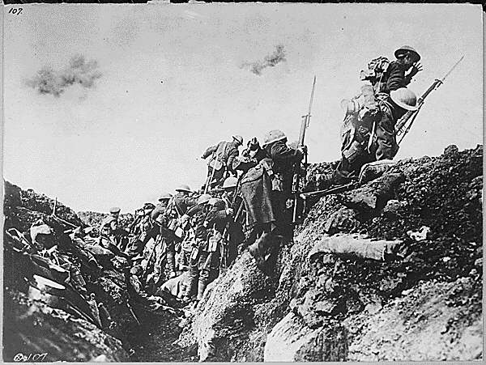
Over the Top
Going ‘over the top’ was leaving the trench to attack the enemy
Was the method of trying to make an advance

Slide 8
No Man’s Land
Corridor between the enemy trenches was called No Man’s Land.
Armed with buried land mines.
Covered with barbed wire entanglements.
Soldiers who ventured out into it were not likely to return.
Diagram time….

Slide 9
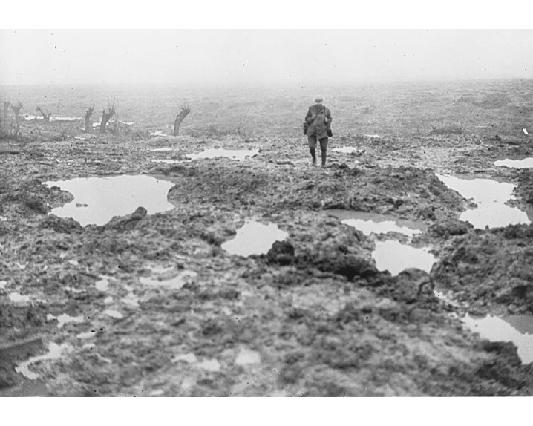
Men who were killed in this area could not be buried because their bodies could not be brought back.
Those who were injured were left there to die.
Men in the trenches had to listen to the cries of agony from their dying comrades.

Slide 10
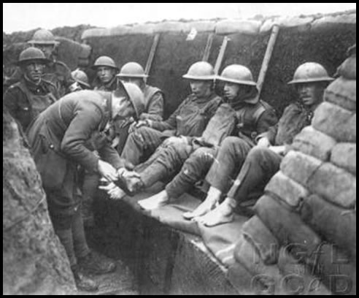
Diseases and Health Conditions
Men were always tired, wet and dirty so sickness spread
The most common diseases were trench foot and trench mouth

Slide 11
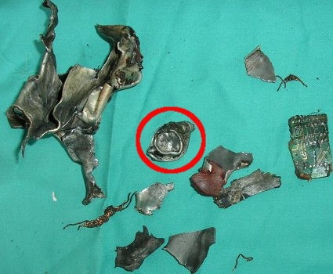
Shrapnel
Exploding metal from shells being thrown through the air
A significant cause of wounds

Slide 12
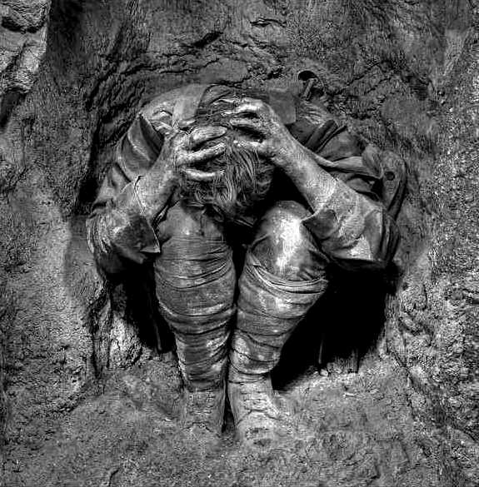
Shell Shock
Men suffered shell shock due to the stress.
They were physically unharmed but their minds and will to fight were destroyed.

Slide 13
Mustard Gas
Burned the eyes and lungs
Effective gas masks invented held filters that purified the air.

Slide 14
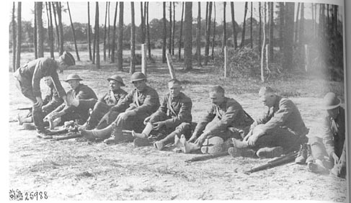
Trench Foot
Foot condition caused by too much exposure to mud and water

Slide 15
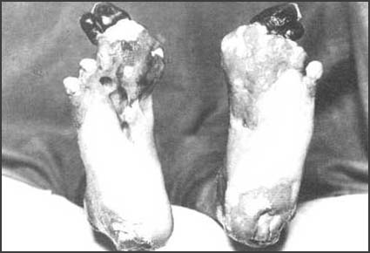

Slide 16
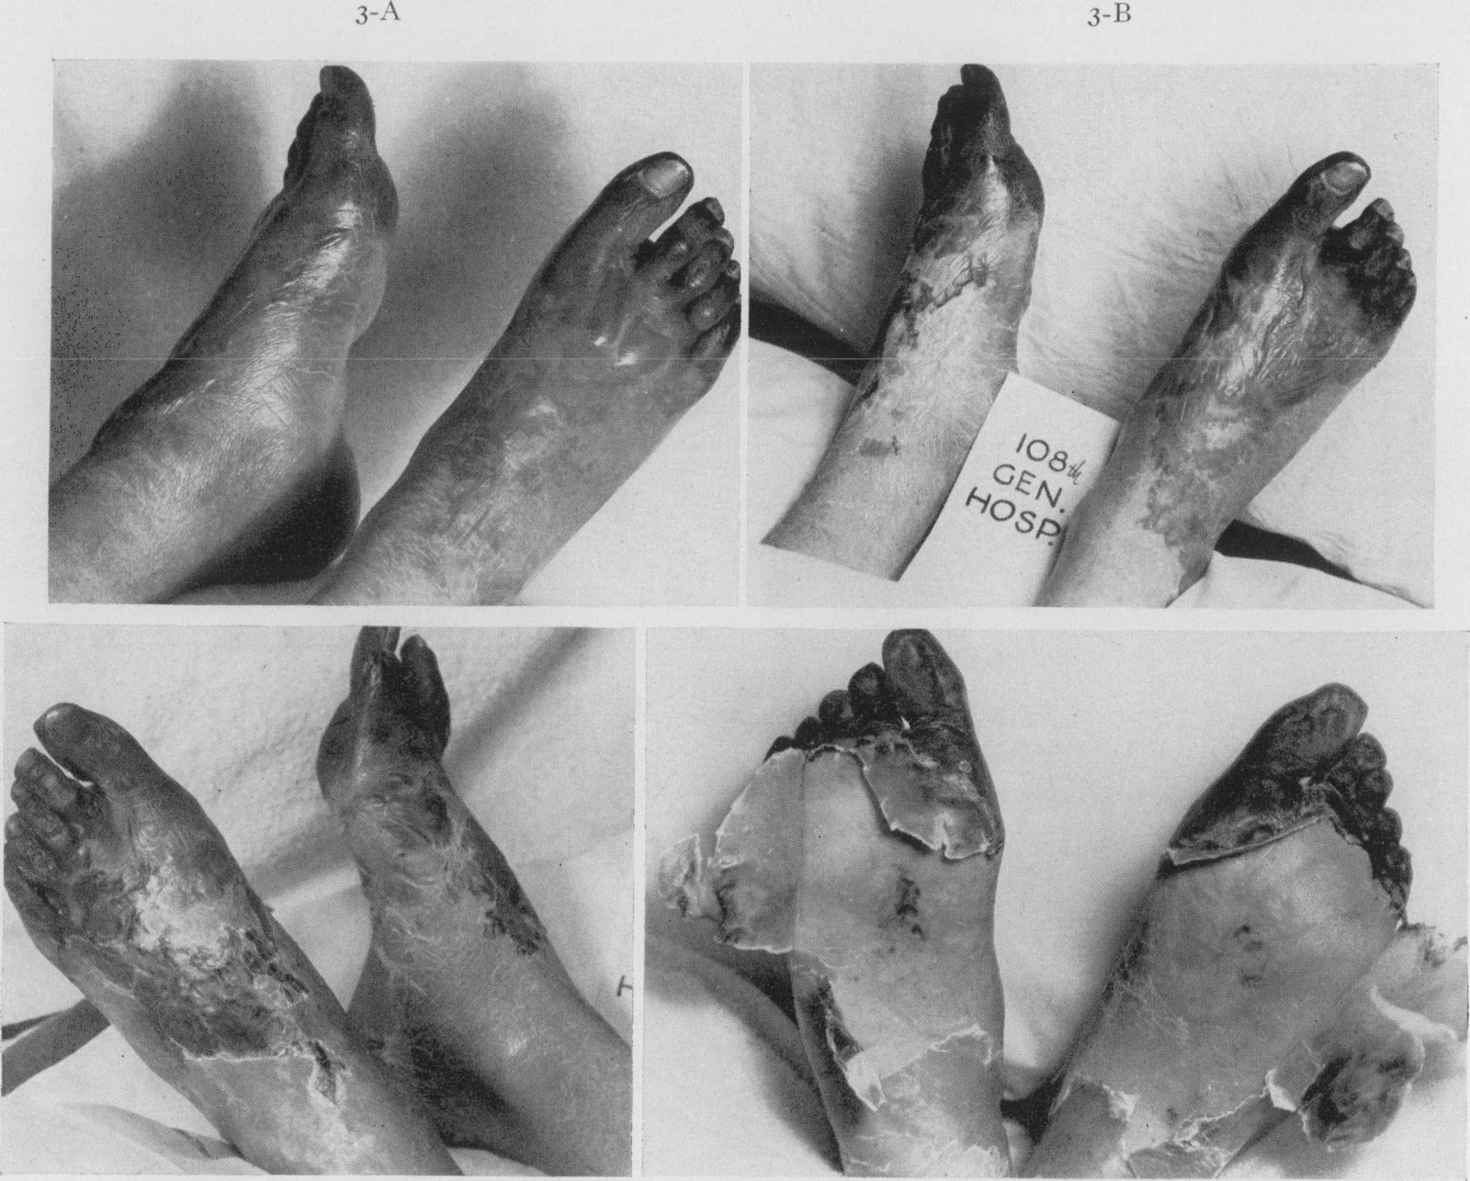

Slide 17
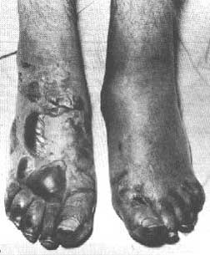

Slide 18
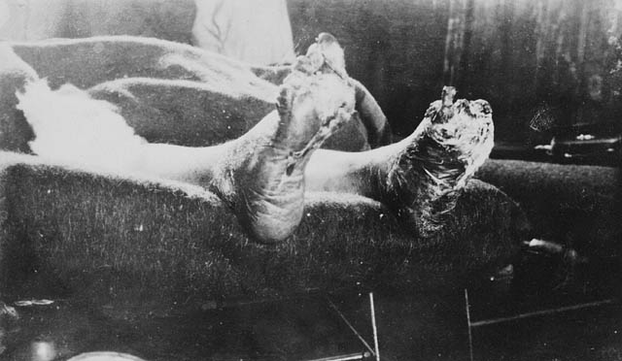

Slide 19
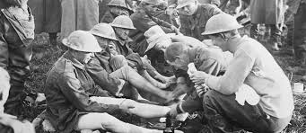

Slide 20
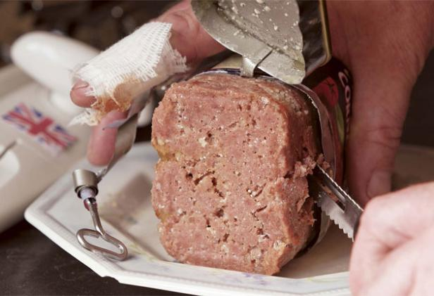
Bully Beef
Canned beef made from low grade meat
War profiteers used the worse quality meat possible to make more profits

Slide 21
The Western Front: 1914
A series of trenches stretching over 700 km across France and Belgium
There was little movement over 1914-1918 – This is referred to as a stalemate

Slide 22
The Western Front: 1914

