Slide 1
Historical Thinking Concepts
This semester we will examine Canadian history through the lens of these Historical Thinking Concepts and apply them to our ten Big Ideas.

Slide 2
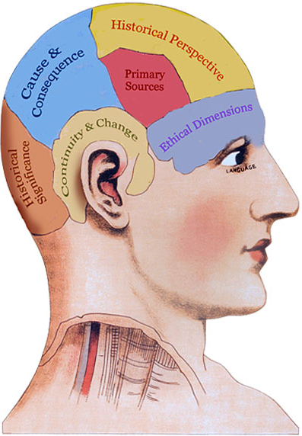
Establish historical significance
Use primary source evidence
Identify continuity and change
Analyze cause and consequence
Take historical perspectives
Understand the ethical dimension of historical interpretations.

Slide 3
Historical Significance
Significance depends upon one’s perspective and purpose. A historical person or event can acquire significance if we, the historians, can link it to larger trends and stories that reveal something important for us today.
.

Slide 4
Historical Significance
Example: the story of an individual worker in Winnipeg in 1918, however insignificant in the World War II sense, may become significant if it is recounted in a way that makes it a part of a larger history of workers’ struggles, economic development, or post-war adjustment and discontent. In that case, the “insignificant” life reveals something important to us, and thus becomes significant.

Slide 5
Primary Source Evidence
Letters, documents, records, diaries, drawings, newspaper accounts and other bits and pieces left behind by individuals from the past are primary sources. We must set them in their historical contexts and make inferences from them to help us understand more about what was going on when they were created.

Slide 6
Primary Source Evidence
Example: A boot print - we examine it to see if it offers clues about the person who was wearing the boot, when the print was made, which direction the person was headed, and what else was going on at that time.

Slide 7
Continuity and Change
Continuity and Change are interwoven: Both can exist together. We will examine change as a process, with varying paces and patterns.
Example: Some people who lived through the 1970s would say that “nothing happened” where in fact, events continuously happened.

Slide 8
Cause and Consequence
Examining the multiple, (involving both long-term ideologies, institutions, and conditions, and short-term motivations) actions and events contributing to any particular event and the resulting events and effects.

Slide 9
Cause and Consequence
Example: the Vancouver anti-Chinese riot of 1887 certainly involved the racial attitudes and motivations of the white workers who rampaged. Did the workers cause the riot? In some sense they did. But the causes must be set in the larger context of employers paying Chinese workers a fraction of the regular wage rate and the desperate situation of Chinese Canadian workers after the completion of the Canadian Pacific Railroad.

Slide 10
Historical Perspective
Taking historical perspective (or historical empathy) means understanding the social, cultural, intellectual, and emotional settings that shaped people’s lives, thoughts, and actions in the past.

Slide 11
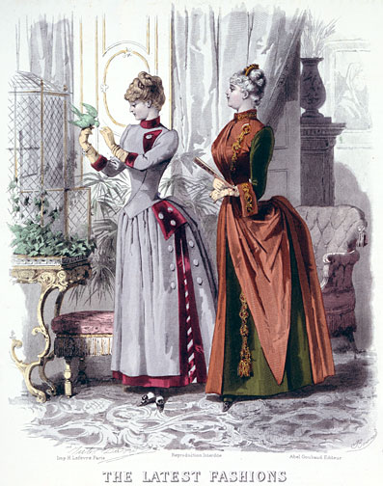
Historical Perspective
Example: In a world of piercings and tattoos, we must adopt a historical perspective in order to understand why women forced themselves into corsets and sported bustles

