Slide 1
Global Citizenship and Getting Active
Learning Goal: I will explore different ways I can be an active citizen
Minds On: What is a global citizen? What does being active mean? How have you been active this year? Semester? In your life?
Action: Note & Video analysis…the verbal message.
Consolidation: How do you feel about Nike now? Text books

Slide 2
What is a Global Village?
the world viewed as a community in which distance and isolation have been dramatically reduced by electronic media (such as television and the Internet)

Slide 3
What is a Global Village?
Even though we are all part of the "global village", only some people believe in maintaining strong values that help sustain and contribute to a better world.
It is important to have a global perspective and to inform yourself about global issues because we are part of an interconnected and interdependent community.

Slide 4
What is a Global Citizen?
People have different opinions about what it means to be a global citizen.
For some, global citizenship means international trade and investment.
For others, global citizenship means being responsible for our Earth, its resources, and our fellow citizens. They are concerned, for example, that technology and industry around the world threatens the environment of the Earth as a whole.

Slide 5
What is a Global Citizen?
Still others see global citizenship as the responsibility to ensure that all the peoples of the world can live in peace, enjoying an adequate quality of life.

Slide 6
Definitions!
Global - looking at the entire world and everything that is in it.
Village - a small community that has shared values and a common vision.
Interconnected - Every action from every person affects the world. For example, our pollution in North America can have an effect on the Arctic or another part of the world. We are "connected" with each other.
Interdependent - We are "dependent" on each other. For example, we hope that other countries and continents control their pollution so that we can live in a stable environment.

Slide 7
Minds On: Video Analysis
https://www.youtube.com/watch?v=j0vYTFve7tA
https://www.youtube.com/watch?v=moC-phhfo70
After each video, fill out the appropriate information for the chart.

Slide 8
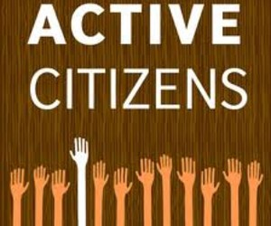
Want to bring about change?
Get Active!

Slide 9
Mahatma Gandhi
“Be the change that you wish to see in the world.”

Slide 10
Why Get Active…
To protect my rights or the rights of others
To change something
To protect existing programs
To protect the environment
To achieve greater power and/or freedom
For social justice or social responsibility
For ethical reasons
To protect my own interests

Slide 11
3 General Ways to Get Active
Cooperation
Non-cooperation
Intervention

Slide 12
Cooperation
Write letters to the editor or government representatives
Hold public meetings and sign petitions
Advertise your cause with flyers, posters, commercials, etc.

Slide 13
Sign a Petition
https://www.change.org/petitions
http://www.amnesty.ca/get-involved/take-action-now/petition-library?gclid=CJHV5bmZiNMCFdW6wAod-JILzg

Slide 14
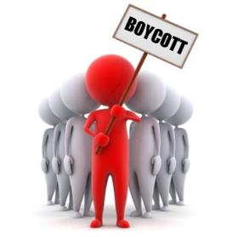
Non-cooperation
Refuse to buy from a certain place or country (boycott)
Refuse to obey a law you feel is unjust
Refuse to pay some or all of your taxes

Slide 15
Boycott of Oil Companies

Slide 16
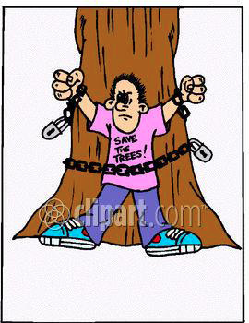
Intervention
Participate in demonstrations
Put yourself between people and groups trying to harm others
Occupy land that is being misused in your opinion

Slide 17
Sit-ins & “Tree-huggers”

Slide 18
Tank Man - https://www.youtube.com/watch?v=SACHK-W4o1E
Behind the Swoosh - https://www.youtube.com/watch?v=M5uYCWVfuPQ
Greenpeace - https://www.youtube.com/watch?v=KokiUgvlwc4

Slide 19
Journal Time!

