Slide 1
Welcome to Canadian History Since 1914!
Ms. Neals
CHC 2P
Room: 215

Slide 2
What Will We Learn?
“Canada is a nation of immigrants”…..what does this mean?
Why are those dudes and the Queen on our money?
Why do most of us speak English in Canada?
Why in 1914 did we decide to go and kill people that weren’t our enemies?
Why in 1939 only 20 years after WWI ended did we go and kill people again?
How do we know that what we have been taught has actually happened?

Slide 3
What will we learn?
Why would some weird little man from Austria want to kill so many people?
What is about Canada that some people in Quebec dislike so much?
Why have we treated Aboriginal People’s so badly?
Should we apologies today for the things that happened in the past?
What was the USSR? What is communism? Is Russia our friend?
Why are people in the middle east trying to get rid of their leaders and are dying for it?

Slide 4
An applied level history class means…
Lectures/Power Points and even some NOTES!
Literacy
Reading…oh no!
Videos (YouTube)/ A Movie or Two
Independence….and Respect
Learning Goals

Slide 5
Evaluation
Termwork 70%
Daily activities
Unit tests
Independent writing tasks
Essay
Literacy test preparation
Demonstrating understanding
In-class Assignment (culminating) 10%
Final Exam 20%

Slide 6
The Typical Grade 10 applied level Student
***Attendance*** - TCOB
Communication with your teacher
Deadlines
Using class time WISELY!
Respectful and Mature
Suffering

Slide 7
Important Stuff…
Classroom Expectations
Respect the classroom and respect each other
Be on time and be an active part of the class
Keep the same measure of respect you show in here out in the halls

Slide 8
Why study history? Why does history matter? Copy these two questions and write a response.
http://www.youtube.com/watch?v=vgmNkYUL_Cw

Slide 9
Why History Matters
History is abused (movies)
YOU are history
“Those who do not understand the mistakes of the past will be forced to repeat them” – George Santayana
Canadian Identity- people all over the world identify you with Canada because of what happened in the past (can you think of an example?) – What will people think in the future?
What would people think if we did not remember things of the past?

Slide 10
How do we look at history?
Close your eyes: pretend you are an Icelandic immigrant living in the area of Lindsay in the early 1800’s and you see a Moose.
Two ways to think about history:
We can be in the shoes of the people of the past and be a part of it to try and understand why
We can never understand the past through people because what they thought in the past is nothing like the way we think today.
So then how do we know anything about history?

Slide 11
Marco Polo’s Unicorn
Marco Polo- 13th century Italian
explorer- recorded his travels
across Asia to China and back
Came across numerous animals and sights he had never seen before and didn’t understand. His recordings show us how we think of things within our own known perspectives

Slide 12
Marco Polo’s Unicorn
“unicorns are scarcely smaller than elephants. They have hair of a buffalo and a single large black horn in the middle of the forehead. They are very ugly brutes to look at…not at all as we describe them to be…”
What was he looking at, that he thought was a unicorn? DO NOT SHOUT IT OUT!!! Write it down!

Slide 13
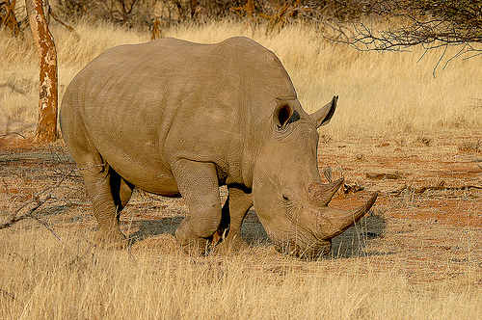

Slide 14
The Point is…
Marco Polo used what he knew to understand what he didn’t know.
As historians we cannot put our present ideas into the events and minds of the past
How to do this: EVIDENCE

Slide 15
How do I know what is evidence and what do I do with it anyway?
Primary source image analysis
Discuss with your group what you think is going on in your photo
Think the 5 W’s – Make up a story about this! (WRITE IT DOWN and be prepared to share!)

Slide 16
What do you think of this quote?
“In Canada, we live in the shadow of the USA… In the purest sense, the very definition of Canadian is “not American.”
(Will Ferguson)

Slide 17
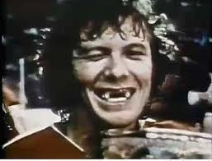
Quote #2
Canada is a country whose main exports are hockey players and cold fronts. Our main imports are baseball players and acid rain. (Pierre Trudeau)

Slide 18
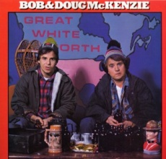
The Misconceptions…

Slide 19
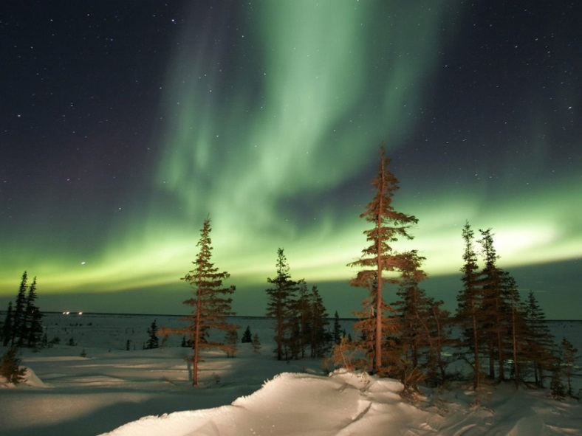
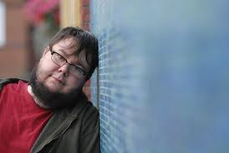
The Reality?

Slide 20
Consolidation – Exit Paragraph
Before you leave:
Write a paragraph based on why you think Canada is a unique and proud country
Not allowed to mention!
Tim Horton’s
Beer
Hockey

