Slide 1
Developing Character
Writers have available to them a variety of methods to reveal their characters. While inexperienced writers often rely on simply TELLING the reader what a character is like, more accomplished writers prefer to SHOW what a character is like.

Slide 2
How an author reveals a character:
What a character says.
What a character does or does not do.
What a character dreams or thinks.
What others say about the character.
How others react to the character.
How the character is described.

Slide 3
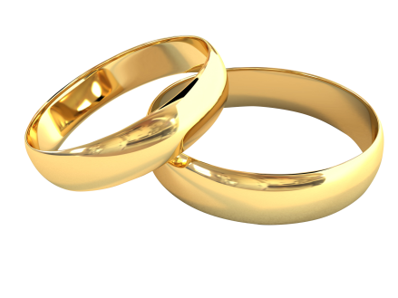
What does it mean?

Slide 4
Lamb to the Slaughter | Evidence | What it tells the reader
What the character says/thinks
What the character does
What other characters say
What the narrator says

