Slide 1
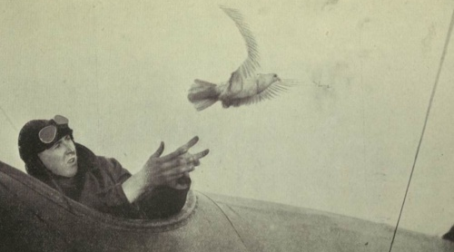
Carrier Pigeons

Slide 2
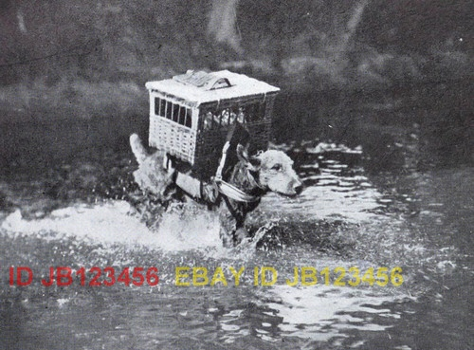

Slide 3
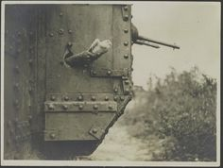

Slide 4
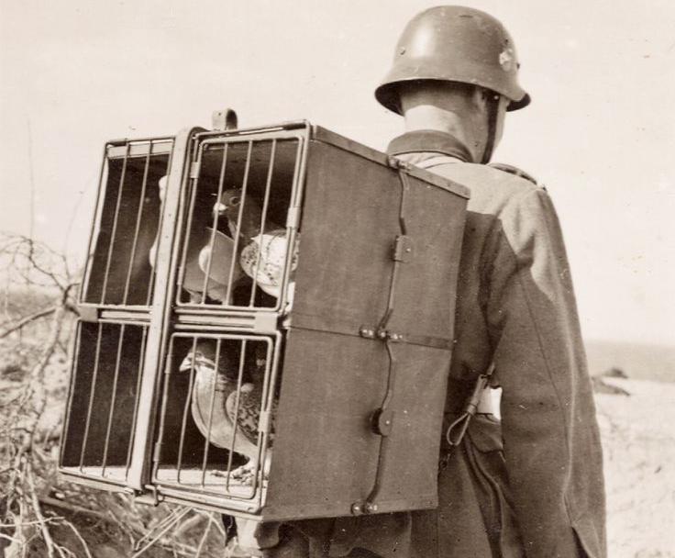

Slide 5
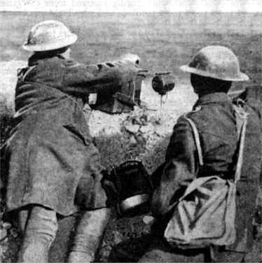
Morse Code

Slide 6
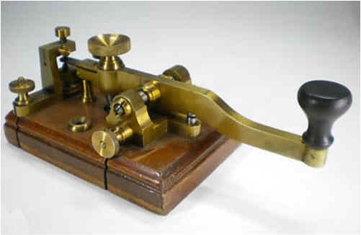

Slide 7
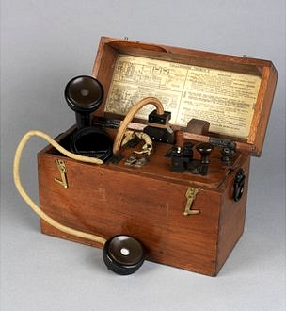
Trench Telephones and Radios

Slide 8
Aerial cables delivered telephone or Morse code messages with lines laid on the ground or buried near the firing line.
Begbie lamp was used for flashing Morse code messages.
Two flags (one white and one blue) were used against light or dark backgrounds.
Electric lamps on a tripod stand were used at night.
Two types of flap or disc instruments opened and shut with the long and short pauses of the Morse code - the one with the three flaps attached to a spring could be attached to a tree or wall).
Heliograph with its mirrors, needed sunshine to transmit messages.
Whistle which could be used for signals with Morse code.

Slide 9
