Slide 1
Historical Roots of Law
Unit 1 Heritage

Slide 2
Early History of Law
Early societies- local customs and beliefs- unwritten and dealt mostly with property and family relationships/responsibilities
As societies grew- in population and size- and in interactions, it became necessary to record them
One consistent characteristic among all of the early written laws- property rights, slavery and the treatment of women and children

Slide 3
The Code of Hammurabi
Discovered in 1901- written between 1792- 1750 BCE
Hammurabi- King of Babylon (Iraq) codified* the rules and penalties for every aspect of Babylonian life
300 laws (how many are in Canada?)
Hammurabi encouraged compliance by attributing the laws to the gods (whom the people feared and respected)
Codified: arranged and recorded systematically

Slide 4
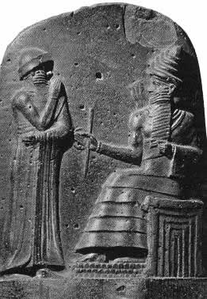

Slide 6
The Code of Hammurabi
Patriarchal society- wealthy more protected then the poor
Slavery legal
Women and children were the property of men
Retribution: justice based on vengeance and punishment
Restitution: payment made by the offender to the victim of a crime or wrong
http://www.youtube.com/watch?v=h534FTPHQoY

Slide 7
Early History of Law
Greatest influence on our law is biblical law, often referred to as Hebrew Law or Mosaic Law
Ten Commandments- Basis of Judaism and Christian values/faith
Commandments are in fact written 450 years after Hammurabi but the basic principles are the same…
However in Mosaic law deliberate acts were more of a concern than accidents
Also in Mosaic law the actual perpetrator was punished and not someone related (as in Hammurabi)

Slide 8
Activity
*Code of Hammurabi analysis activity
MONDAY!

Slide 9
Greek Law
Democratic development
Concept regarding administration- citizens should have a say in major decisions (in Athens, citizens had to be male, of a certain age and not slaves)
This is applied through the invention of the jury system
400 BCE- juries ranged from a few hundred to a recorded jury of 60000

Slide 10
Roman Law
Roman Empire 100 CE
Two basic principles- law must be recorded (written) and justice could not be left to judges alone
Recorded forms of Roman Law were the Twelve Tables 450 BCE and Justinian’s Code 529 CE
Twelve tables organized public prosecutions, compensation for victims and protected the poor lower class from the rich
Justinian’s Code- Civil and Criminal law distinction, clarified in common language- creation of Lawyers

Slide 11
Napoleonic Code
1804 Emperor of France
Spread through most of Europe even after 1815
Non-technical style, regulated civil matters such as wills and contracts and family law
Still used as a basic in Quebec for their civil law- very property based

