Slide 1
Common Law
Development of Canadian Law-
Early History of Law Part 2

Slide 2
Common Law
1066 William the Conqueror invaded England
Feudalism- a political, social and economic system that relies on a hierarchy based on loyalty
King owns the land- divides it amongst nobles and lords- in return the nobles and lords promise loyalty (taxes, food, etc.) and military service
Lords/Nobles own huge areas of land where people on these lands owed loyalty to them

Slide 3
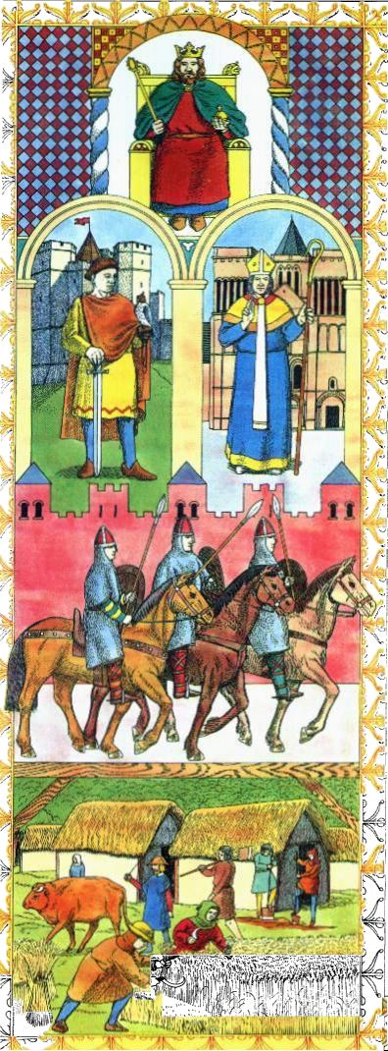
Feudal System
Church
Grants land to nobles in
return for loyalty and
military service
King
Provide land in return for
loyalty, protection and military service
Nobility
Are provided with land in return for protection and military service
Knights
Landless – are provided with protection and a place to live in return for labour, loyalty and military service if needed
Food stuffs
&
Tax
Serfs – Peasants

Slide 4
Development of Common Law
Lord’s land was called a manor and they ruled it as they saw fit- they acted as judge in any trial of anyone accused of breaking his law on his land
Problem?
Eventually in the 1100’s King Henry 11 appointed travelling legal experts to hear cases- once they returned to London they created similarities in judgments- Case Law
Cases could now be referred to for similar cases to provide similar punishments- common law based on precedent
Introduced to North America by colonists

Slide 5
Common Law
Rule of Precedent- something that has been done before
A ruling in one case can later determine how future cases are handled
Consistency
Appeals allowed- all people in England could appeal their decision to the king- In Canada we have an appeal process in order to review decisions of lower courts

Slide 6
Precedent
http://www.youtube.com/watch?v=nIxf1JaglI0&safe=active
Lawyers and judges today refer to earlier decisions on cases that are similar or identical to the one they are dealing with as precedents
Certainty into the law for everyone to see- likely outcome in cases
Lawyers try to persuade judges by referring to precedents in cases
Today: SCC rules on Physician assisted suicide…

Slide 7
Citations
In order to have case law and for precedents to be used, we have to have an organized way of recorded cases
Citations
See handout
Page 18 in text

Slide 8
Legal Reforms
Henry also originally set up a system of juries (only for property issues)
Henry’s reforms actually decreased his power since now administration of laws and governing didn’t have to be done by him
His grandson John became King in 1199- bad dude, did like giving up power to judges
Nobles and Barons forced him to sign the Magna Carta

Slide 9
Rule of Law and the Magna Carta
King John 1199- 1216- abused his position
English nobility forced King John to sign the Magna Carta in 1215- the principle of the Rule of Law
All rulers must obey the law- rulers can not restrict freedoms of the people without just cause- people’s rights cannot be changed without their consent- people cannot be held arbitrarily
Habeas Corpus- the authority making the arrest to bring the detained person before a judge to determine the validity of the arrest

Slide 10
Rule of Law and the Magna Carta
Canadians are governed by the rule of law
Government officials cannot make up or change the rules without consulting anyone else
The rule of law exists because our society believes there should be equality under the law and all decisions must be made with reason
Roncarelli v. Duplessis handout

Slide 11
Parliament and Statute Law
Parliament- law making body of a country- elected
Removes a lot of power from one ruler- Democratic
All laws in Canada must be passed by Parliament. These laws are called statutes (see handout)
Due to our heritage of English law many laws were not written but known through common law- precedents are set by judicial decisions- this is called Case Law
Example- The Criminal Code is a Statute, passed and amended by the Parliament
Example- R. v. Morgantaeler- Judge determined that the government could not make laws that violate a women’s right to their own bodies- Abortion

