Slide 1
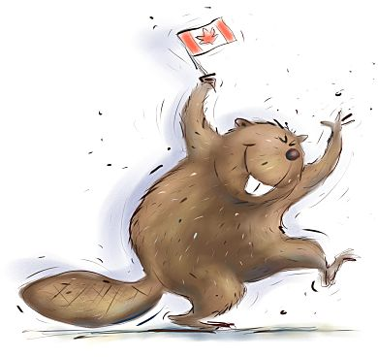
Canadian
Citizenship

Slide 2
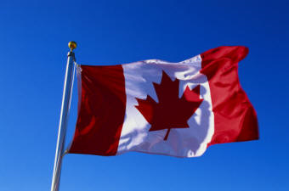
What is a citizen?
Someone who is by birth or
naturalization a legal member
of a nation and who, as a result,
has the rights and responsibilities
of citizenship

Slide 3
What makes a “good”
citizen?
Follows laws and ethics
Participates in society
Respects all cultures
Pays taxes
Helpful towards others
Volunteers/gives back
Contributes to the economy

Slide 4
What makes a “bad”
citizen?
Breaks/disobeys the law
Disrespects other cultures
Harms the environment
Puts themselves/others in
danger
Disturbs the peace
Acts selfishly
Does not vote

Slide 5
The meaning of
citizenship
As a citizen, you are entitled
to many rights
Along with every right comes
responsibility
We are all citizens in many
ways; in our families, school,
city and in Canada

Slide 6
Citizen’s Circle
Country
Province
City
Community
ME
(family, friends)
Groups, Clubs,
Sports
What you belong to
in City of Kawartha Lakes
What provincial
affairs you are involved in
What makes you a
Canadian citizen

