Slide 1
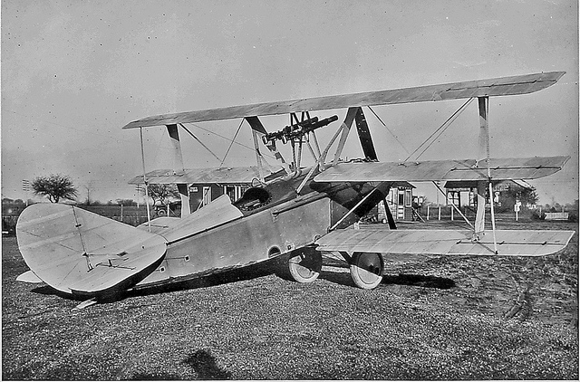
Mind’s On
What are some good features of this plane?

Slide 2
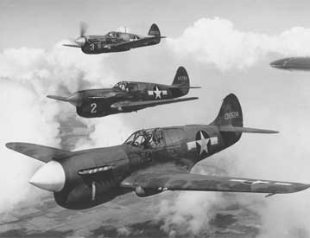
Compare it to this plane

Slide 3
Canada and the Battle of Britain

Slide 4
Sept 1939, Spring 1940
Sept 1939 - crushed:
Poland > 1 month
The Phoney War (Winter 1940) when no fighting took place
Spring 1940 - Crushed:
Denmark - 1 day
Norway - 2 days
The Netherlands – 5 days
Belgium – 18 days
France – 6 weeks

Slide 5
The Fall Of France
The Nazis occupied France in June of 1940, the next plan was to invade England.
The Defence of Britain depended on the Royal Navy and the Royal Air Force (RAF).
Hitler needed to clear the English Channel before even considering an invasion of England.

Slide 6
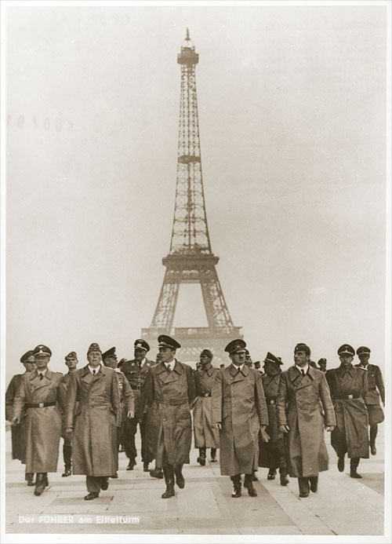
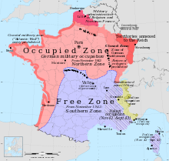

Slide 7
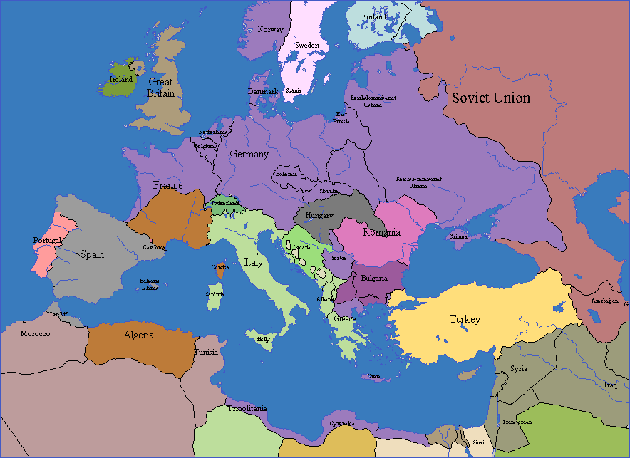

Slide 8
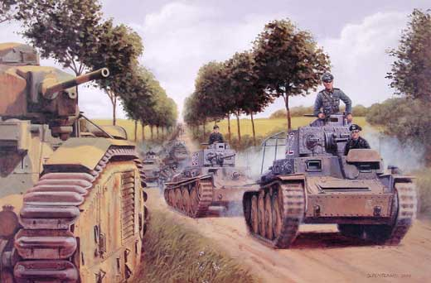
Blitzkrieg – the Plan Operation Sea Lion
Air attack using Luftwaffe
Take out strategic sites
Create chaos in civilian population
Paratroopers secure strategic sites
Armored tank attack – break through into towns (create an entry ‘column’)
Infantry attack (troops arrive in truck loads – enter after tanks
City surrenders

Slide 9
Problems for the Nazis
The Luftwaffe were not yet designed for long range missions.
Britain also had an early radar system that allowed them to detect and track aircraft.

Slide 10
Phase 1 – The Channel war
Phase 1 began in July and lasted until mid August with Germany attacking shipping and port facilities in the English Channel.
During this phase, both sides began to lose planes and pilots.
Replacing both would be difficult for Britain and Germany, but Britain had help.

Slide 11
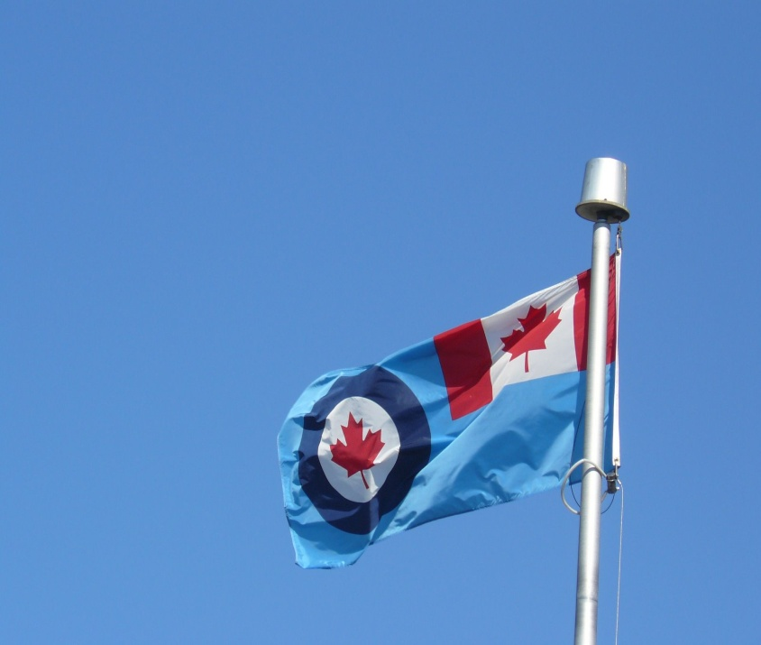
Canadian Assistance
Canadian businessman Lord Beaverbrook organized massive aircraft production.
Beaverbrook was able to keep the RAF supplied with planes to replace heavy suffered by the British.
The RAF also lost many skilled pilots (only had 3000 to start)

Slide 12
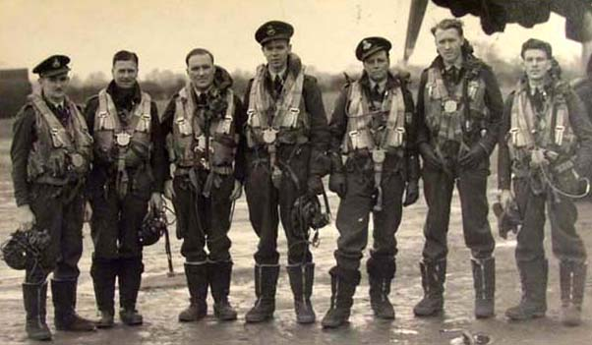
Canada and Pilots
Nearly 15% of RAF pilots during the Battle of Britain were Canadians.Also, pilots and air crew were being trained in Canada.
Canadian assistance in these areas proved to be invaluable to Britain.

Slide 13
Phase 2: Eagle Attack
In August the Germans began attacks on radar stations and airfields.
By early September the Germans seemed to be winning but Hitler’s impatience caused him to change his strategy.

Slide 14
Phase 3: The Blitz
In this phase Germany began to attack cities.
On September 7, 1940; 1000 German bombers attacked London.
Hitler’s hope was that the public would pressure the British gov’t to surrender.

Slide 15
Knowing where to bomb
Targeting London was easy – pilots simply had to follow the River Thames which took them straight to the important St. Katherine’s Docks in the East End.
The first bombers dropped incendiaries (fire bombs) to light the way for the following explosives bombers.

Slide 16
Defending Britain
This was a tough challenge – Britain had no night time fighters.
Searchlight and the newly discovered radar helped as an early warning system.
Anti-Aircraft guns and barrage balloons were the only obstacles facing the Luftwaffe.

Slide 17
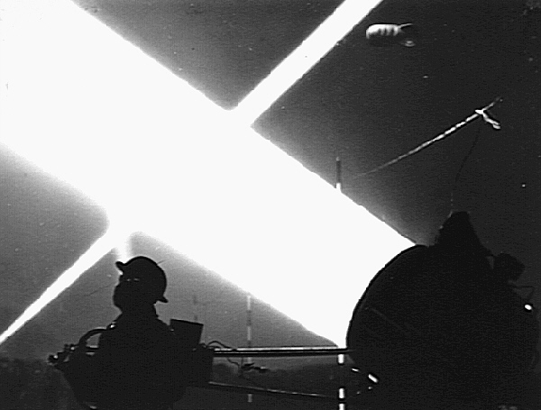

Slide 18
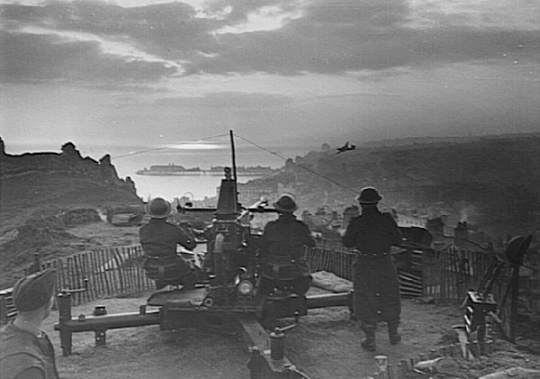

Slide 19
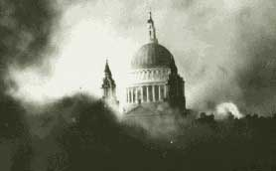

Slide 20
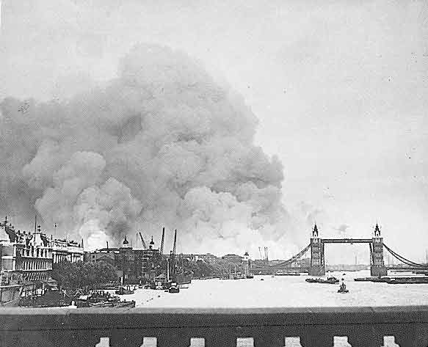

Slide 21
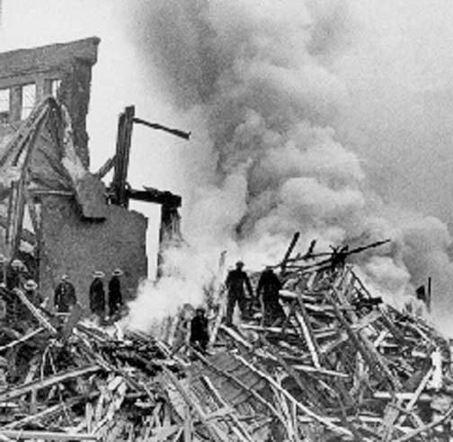

Slide 22
Britain’s Response
The British responded by evacuating thousands of people from London into the countryside (think Narnia without the wardrobe!), including 6000 children sent to Canada.
Each day the British would awake to rebuild their cities rather than surrender
1000’s of people slept in shelters and even the Underground (London’s subway system)

Slide 23
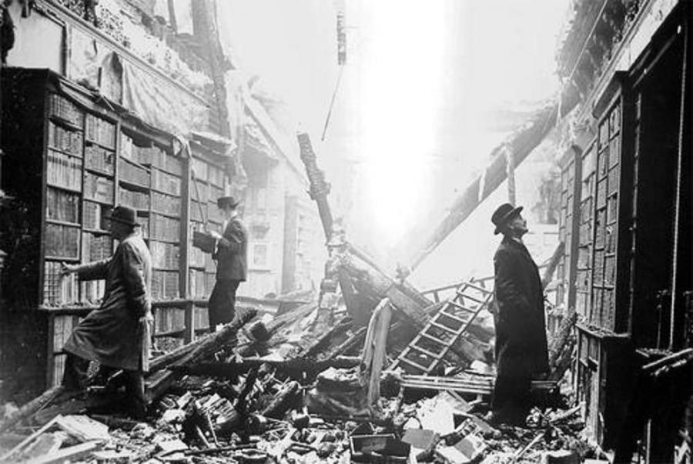
How were people affected?
People found whole streets had gone.
Rescue efforts saved people from rubble.
1000s of people were made homeless.
But as you saw in the film life went on for most.

Slide 24
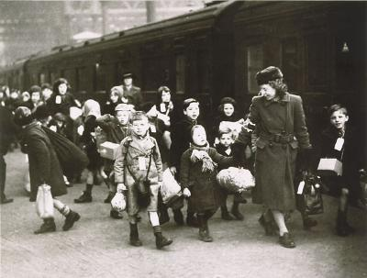

Slide 25
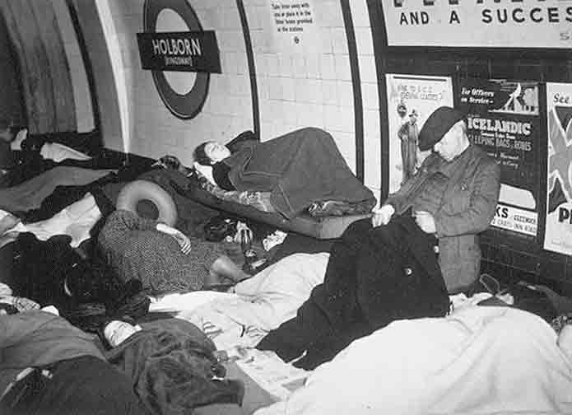

Slide 26
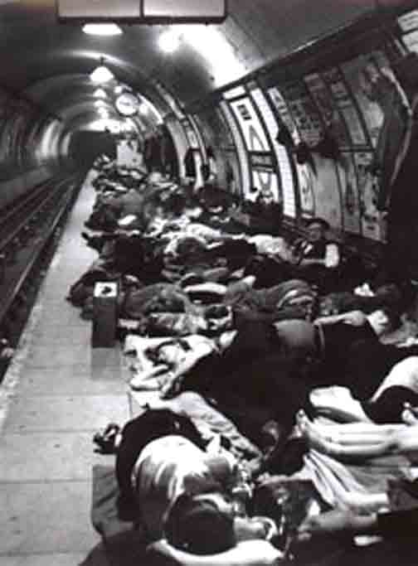

Slide 27
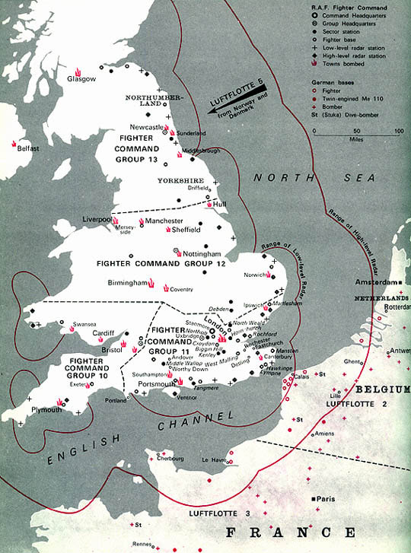

Slide 28
Was the Blitzkrieg successful?

Slide 29
The Battle of Britain Ends
By September 12th the threat of an invasion passed because the weather and sea conditions were not favourable to a large scale invasion.
Although the bombing continued, Germany was left with a weakened Luftwaffe and Britain still would not surrender!
For the first time, Hitler did not win.

Slide 30
Was Germany Bombed?
Yes. Far worse than Britain was.
For every 1 tonne of bombs dropped on British cities the RAF and the US Air Force dropped 315 tonnes on Germany.
The worst raids were on the city of Dresden in 1945, which you can see afterwards in this picture.

Slide 31
Final Thought…
The total number of civilian casualties in Britain during the war was 67,800.
The total number of civilian casualties in Germany was 1,600,000.
Who really came off worst?

