Slide 1
ANTIGONE
By Jean Anouilh

Slide 2
Greek Sources of the Play
The Theban Plays by Sophocles

Slide 3
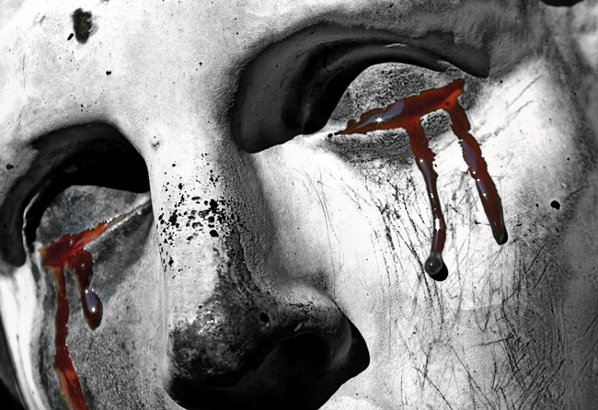
OEDIPUS THE KING
First play in the trilogy
Plot:
King Laius and Queen Jocasta of Thebes have a child
A soothsayer tells them that this child will one day murder Laius
They take the child, Oedipus, to the wild and leave him there
The child is rescued and raised by people far away from Thebes

Slide 4
OEDIPUS THE KING
Plot, cont’d:
When Oedipus grows to manhood, he chances to meet Laius on a road one day, gets into an altercation with him, and kills him
Later in his life, Oedipus makes his way to Thebes, who now no longer have a king
Oedipus takes on the job, solidifying his position by marrying Queen Jocasta (his mother, though of course he does not know this)

Slide 5
OEDIPUS THE KING
Plot, cont’d:
Thebes begins to experience natural disasters
Oedipus consults the soothsayer Tiresias, who tells Oedipus that he knows why the disasters are occurring, but does not want to tell Oedipus why
Oedipus, whose hamartia is curiosity, will not let the matter go, and Tiresias tells him that he has killed his father and married his mother

Slide 6
OEDIPUS THE KING
Plot, cont’d:
Jocasta, the Queen, kills herself after hearing this news
Oedipus does not kill himself or die at the end of the play, but he does punish himself by sticking spikes in his eyes, blinding himself

Slide 7
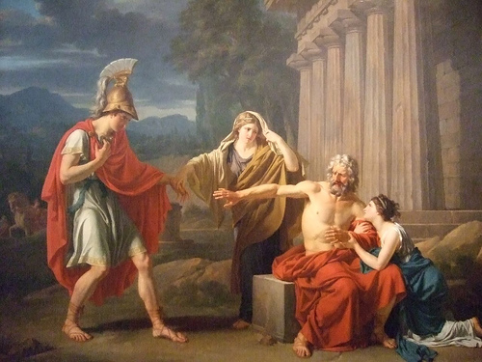
OEDIPUS AT COLONUS
The second play in the trilogy
Plot
Not terribly important to know the details of this play
Mainly just about Oedipus’ journeys after he abdicated the throne and wandered the land as a blind man
Antigone, his daughter, plays a part in this play as Oedipus’ guide

Slide 8
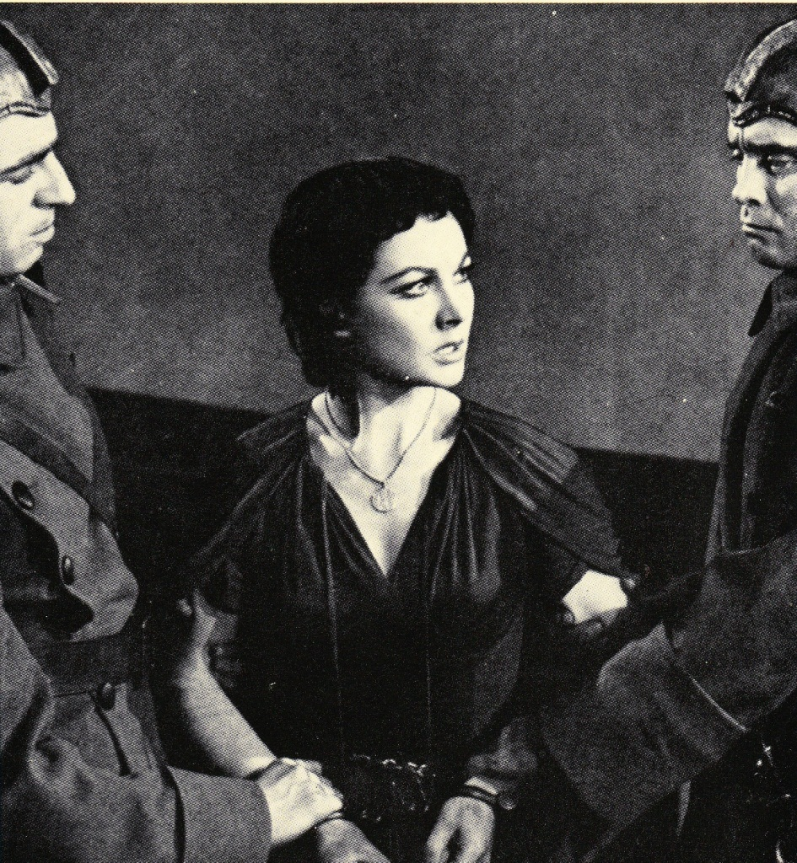
ANTIGONE
The last play in the trilogy
Setup
Oedipus is now dead
Oedipus’ sons, Eteocles and Polynixes, were given the order to rule Thebes jointly, splitting the power and taking turns year by year
Eteocles refused to give up his power after the first year, and the two brothers went to war
Vivien Leigh as Antigone
(first English production, 1949)

Slide 9
ANTIGONE
Setup, cont’d
The two brothers were both killed in the conflict, and the kingship of Thebes went to Oedipus’ brother Creon
Creon decreed that the “official position” of his new government would be that Eteocles was in the right and Polynixes was in the wrong
Creon further decreed that Eteocles would be given a state funeral and Polynixes’ body would be left to rot
Anyone trying to bury Polynixes’ body would be executed – IMPORTANT PLOT POINT!
Vivien Leigh as Antigone
(first English production, 1949)

Slide 10
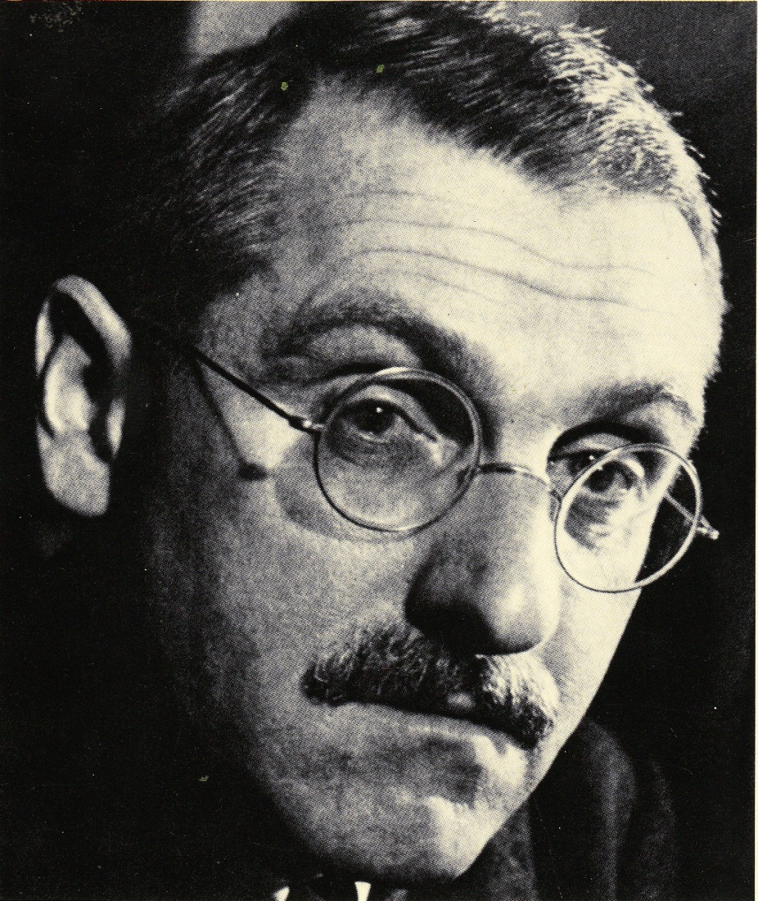
JEAN ANOUILH
French playwright
1910-1987
Lived and wrote in France during World War II
Often wrote plays influenced by classical themes, ideas, and works
Decided, during World War II, to write a version of Antigone that would have modern political overtones

Slide 11
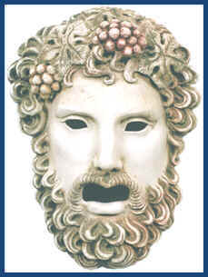
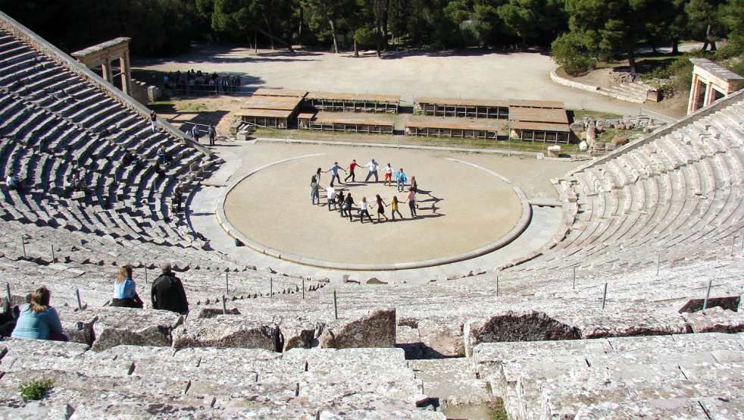
Major Changes to ANTIGONE
The play is not meant to be played as an Ancient Greek play
NO masks
NO amphitheatre stage (conventional proscenium stage is suggested)
Setting both IS and IS NOT Ancient Greece
Anouilh was looking for something “timeless”
Costumes are neutral
Anachronisms come up several times in the dialogue (clothing and technical references)

Slide 12
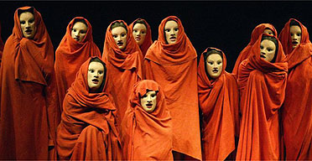
Major Changes to ANTIGONE
The play is not meant to be played as an Ancient Greek play
NO group chorus
The Chorus is a single actor
His lines are spoken, not chanted

Slide 13
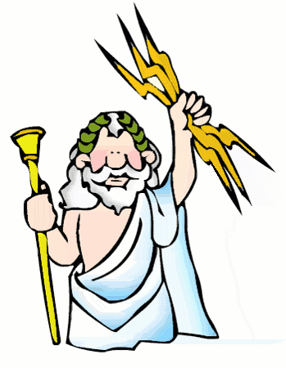
Major Changes to ANTIGONE
The play is not meant to be played as an Ancient Greek play
NO supernatural elements
The soothsayer Tiresias, who does appear as a character in Sophocles’ version of Antigone, is notably absent
“The gods” are discussed, but there is NO evidence whatsoever of their influence

Slide 14
The Political Situation
France in 1944

Slide 15
Question:
Who was the ruling power in France in 1944?

Slide 16
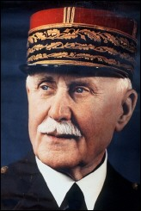
Answer:
Marshal Philippe Pétain
Head of State
“Vichy” France

Slide 17
Question:
Who was REALLY the ruling power in France in 1944?

Slide 18
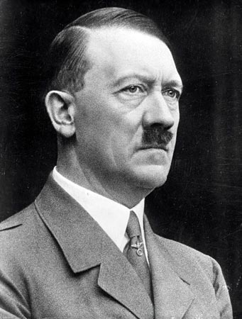
Answer:
This Guy
Recognize him?

Slide 19
WHY WAS ADOLF HITLER IN CHARGE OF FRANCE?

Slide 20
What is the “French Resistance”?
Also known as the “Maquis”

Slide 21
FINAL THOUGHT…
Antigone is a play about a character who resists a draconian, dictatorial government.

