Slide 1
And Then there were none
Agatha Christie

Slide 2
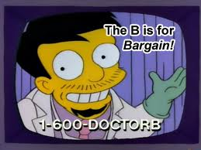
Dr. Edward George Armstrong
Recovering alcoholic
Accused of killing Louisa Mary Clees on March 14th, 1925.
What else do we know?

Slide 3
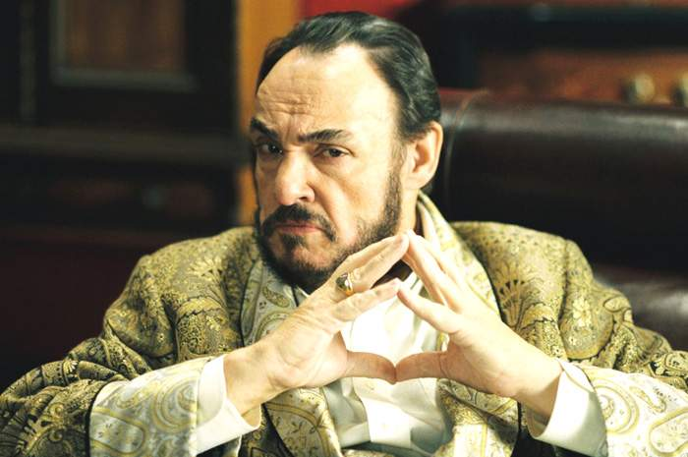
Judge(Justice) Lawrence Wargrave
A recently retired judge and a highly intelligent old man.
He is accused of murdering Edward Seton on June 10th, 1930.
What else do we know?

Slide 4
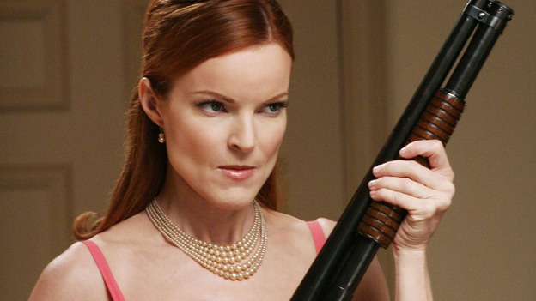
Emily Caroline Brent
Uptight woman from “high society” with strong moral and religious beliefs.
Accused of killing Beatrice Taylor on November 05th, 1931.
What else do
we know?

Slide 5
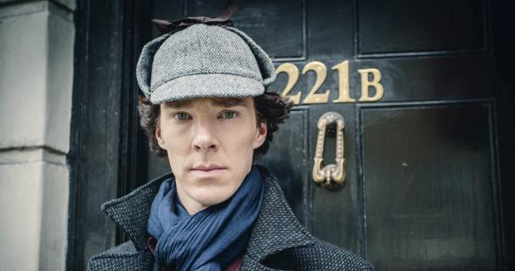
Inspector William Henry Blore
Came to the island with a fake name. Is open about his lack of remorse or consideration of others.
Accused of killing
James Stephen
Landor on October
10th, 1928.

Slide 6
Vera Elizabeth Claythorne
A young women seeking a secretarial job on the island. Plagued by memories of her former life.
Accused of killing Cyril Ogilvie Hamilton on August 11th, 1935.

Slide 7
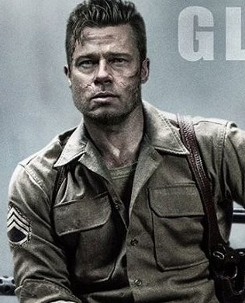
Philip Lombard
A mercenary soldier who has spent time fighting in Africa.
Accused of killing 21 members of the East African tribe February, 1932.

Slide 8
General John Gordon Macarthur
Keeps to himself on the island. Seems nervous as though he is waiting for something to happen.
Accused of killing his wife’s lover, Arthur Richmond, on January 04th, 1917.

Slide 9
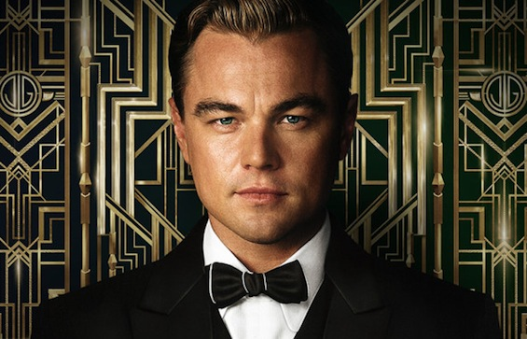
Anthony (Tony) James Marston
Young, arrogant and rich. Described as a “Norse God” in appearance. Shows no remorse for his actions.
Accused of killing John and Lucy Combes in a hit and run.

Slide 10
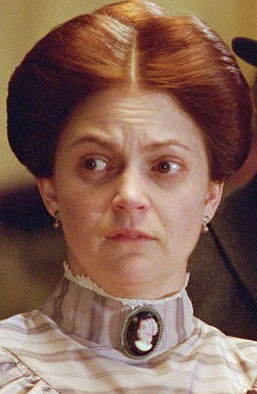
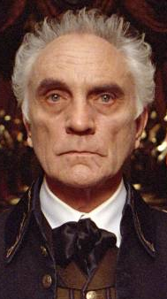
Thomas and Ethel Rogers
An old married couple hired to take care of the house and guests. Ethel is described as looking terrified.
Accused of killing Jennifer Brady, an elderly lady in their care, in order to inherit her wealth.

