Slide 2
Gertrude’s Betrayal and Allegiance
“Mad as the Sea”
“He weeps for what he has done”
Gertrude promises Hamlet she will not tell Claudius about Polonius and Hamlet’s feigning madness, however, she runs to him immediately…
Why does she do this? Is she trying to protect her son by lying to Claudius? Or, does she really think Hamlet's gone off the deep end? Where do Gertrude's loyalties lie at this point in the play?

Slide 3
Claudius as Supervillain
His discussion with Gertrude demonstrates his obsession with ambition and averting public danger rather than justice.
Concern for Gertrude’s safety?
  Claudius seemed more concerned with whether he would have been in danger rather than whether or not Gertrude was in danger.
  Sends Hamlet away to avoid political crisis (does the kingdom like Hamlet more than Claudius?
  He plots again – his conniving ambition becomes more obvious

Slide 4
Claudius as Supervillain
“Let him go, Gertrude. Do not fear our person.(safety) There’s such divinity doth hedge a king that treason can but peep to what it would, acts little of his will.” (IV, v)
{God protects the king so traitors can’t hurt him…oh really?}

Slide 5
Hamlet hides a body…
“Nothing but to show you how a king may go a progress through the guts of a beggar.”
Death and Decay – Hamlet again is obsessing over death. Once you are dead, your body becomes worm food and a beggar may eat a fish caught using a worm that ate a dead king.
Instead of being overwhelmed with contrition or utterly crushed by his guilt at killing an innocent man, Hamlet seems more desperate and self-righteous.
…Oh, and Claudius put a hit on him.

Slide 6
Hamlet’s Finds Inspiration in Fortinbras’ Army
[…] I do not know
Why yet I live to say 'This thing's to do,'
Sith I have cause, and will and strength, and means
To do 't. Examples gross as earth exhort me:
Witness this army of such mass and charge,
Led by a delicate and tender prince,
Whose spirit with divine ambition puffed
Makes mouths at the invisible event,
Exposing what is mortal and unsure
To all that fortune, death and danger dare,
Even for an eggshell. Rightly to be great
Is not to stir without great argument,
But greatly to find quarrel in a straw
When honor's at the stake. How stand I, then,
That have a father killed, a mother stained,
Excitements of my reason and my blood,
And let all sleep, while, to my shame, I see
The imminent death of twenty thousand men
That, for a fantasy and trick of fame
Go to their graves like beds, fight for a plot
Whereon the numbers cannot try the cause,
Which is not tomb enough and continent
To hide the slain? O, from this time forth
My thoughts be bloody, or be nothing worth!
(4.4.46-69)
Turning point for Hamlet.
Realizes his fickleness in leaving after not achieving his goal
Turns his sights and motives “bloody” and is intent on revenge

Slide 7
Laertes as a Foil for Hamlet’s
Direct path to revenge
Does not try and hide purpose
Opportunity for Claudius to plot some more
Compare Laertes’ reaction to his father’s death to Hamlet’s reaction to the death of King Hamlet. (compare the two in your notes)
How came he dead? I'll not be juggled with.
To hell, allegiance! Vows, to the blackest devil!
Conscience and grace, to the profoundest pit!
I dare damnation. To this point I stand,
That both the worlds I give to negligence,
Let come what comes, only I'll be revenged
Most thoroughly for my father.
(4.5.148-154)

Slide 8
“I dare damnation”
Laertes doesn’t care about the consequences of whether his soul will go to Heaven or Hell.
Claudius, “And where the offense is, let the great ax fall.” {may the guilty party (Hamlet) be punished by death}

Slide 9
Ophelia and the “double standard” conundrum
OPHELIA
By Gis and by Saint Charity,
Alack and fie for shame,
Young men will do 't, if they come to 't;
By Cock, they are to blame.
Quoth she, 'Before you tumbled me,
You promised me to wed.'
So would I 'a done, by yonder sun,
An thou hadst not come to my bed.
(4.5.63-71)
Ophelia is singing a song of a girl being “deflowered” as she is literally giving flowers away…odd?
Either a girl gets dumped because she wont sleep with a guy, or, gets dumped because she does, and destroys her reputation…Which one is Ophelia?

Slide 10
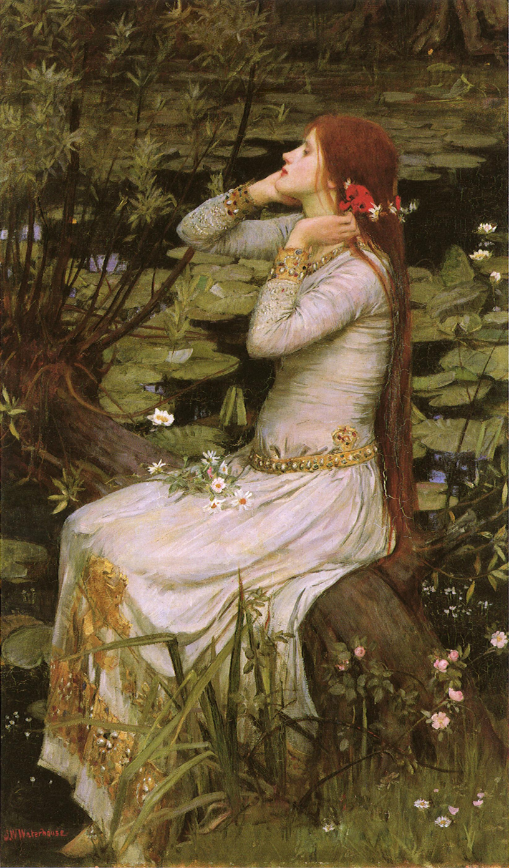
Was there meaning to her choice of flowers?
Rue and Wormwood used for centuries in abortion “recipes”
Hamlet – Rosemary (remembrance, and was distributed and worn at weddings, as well as at funerals)
Laertes – Pansies (Melancholy (too much yellow bile?) symbol of thought, of pensiveness, and of grief)
Claudius – Fennel (flattery, or cajolery and deceit) & Columbines (ingratitude)
Gertrude – Rue (repentance)

Slide 11
[…] poor Ophelia
Divided from herself and her fair judgment,
Without the which we are pictures or mere beasts;
(4.5.91-93)

Slide 12
Ophelia’s Death
Why/how does the queen know so much about what she looked like when Ophelia was drowning?
What qualities does Gertrude associate with Ophelia’s drowning? What does this lead us to believe her perception of death is?
QUEEN
There on the pendent boughs her coronet weeds
Clamb'ring to hang, an envious sliver broke,
When down her weedy trophies and herself
Fell in the weeping brook. Her clothes spread wide,
And mermaid-like, awhile they bore her up,
Which time she chanted snatches of old lauds,
As one incapable of her own distress
Or like a creature native and endued
Unto that element. But long it could not be
Till that her garments, heavy with their drink,
Pull'd the poor wretch from her melodious lay
To muddy death.
(4.7.197-208)

Slide 13
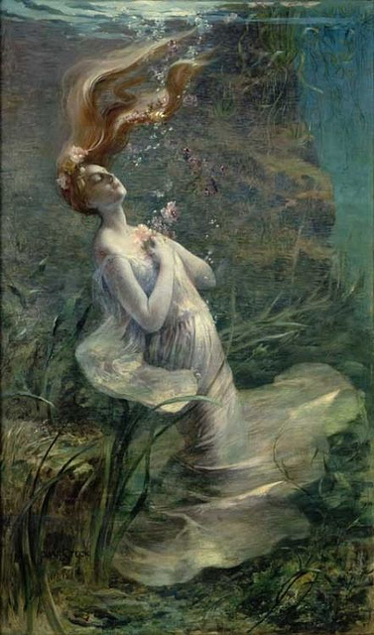
Madness from Patriarchal Pressures and Abuse
Passive death – falls in the water and neglects to save herself.
“garments” pull her down…another “something” telling her what to do…
“native” creature of the water…dead is natural?
- What role does this leave for women at court?

